Slide 1
BLE-Mesh 6 Hour Workshop
Greg Carson, Mike Roberts, Victoria Bohanna Pea
BLE-Mesh 6HR Workshop 2019
Notes:
Aligns with BMD-01-Revxx-Tour-ModusToolbox.docx
Aligns with portion of WBT101-01-Tour from GitHub https://github.com/iotexpert/WBT101
Portions from file found linked to Documentation tab of https://www.cypress.com/products/modustoolbox-software-environment. (ModusToolbox documentation can be found on the web per the above link or in ModusToolbox in the Documentation section)
ModusToolbox™ IDE User Guide Rev *A @ https://www.cypress.com/file/455211/download
ModusToolbox™ IDE Quick Start Guide Version 1.1 @ https://www.cypress.com/file/455221/download
Eclipse IDE Survival Guide KBA225399 Rev *H @ https://community.cypress.com/docs/DOC-15617

Slide 2
Revision 07 – Changes needed and completed
Changes Made:
Open Actions:
Complete table in “Peripheral – Common Choices” around slide 50
Pull detailed Pre-Requisite procedures out of main deck for ModusToolbox, SDKs and BLE_Mesh Apps.
Insert a slide that lists all Pre-Requisites and points to page and document that describes how to obtain them
Remove Blinky LED and Interrupt examples. Leave only Binky Print as first example before Mesh examples.
Consider putting Blinky LED into Pre-Requisites as a project customers can attempt and bring with them to the workshop. This will give them time to understand the structure of ModusToolbox and its resources.
Move first Mesh Exercise before CCM and Client Control to let customers experience valid data with these tools.
Add a Mesh exercise or demo with multiple forced hops. Possibly have two separate devices out of range that can pass information outside of the Mesh. One turns on some combo of RGB. The other reads levels of RGB light. Both are out of range of any BLE transmitter in class so messages have to have the correct number of hops to get to them.
If a long mesh that requires hops is setup, can it be remotely provisioned and de-provisioned all through the nodes? Does de-provisioning need to be performed in specific sequence, so last Node comes off mesh first?
Add step by step procedures or troubleshooting tips for Apple Mac (and possibly Linux). Key here are which versions of iOS are supported or have been verified. Something here about /dev/tty.usbmodem… and /dev/tty.usbserial… to find drivers. Type in “ls /dev/tty.u*”.
Add ADI training on resources and tools ADI recommends when designing in their sensors.
Notes:
Remove this slide before final publish.

Slide 3
Introduction to Modus Toolbox
Greg Carson, Mike Roberts, Victoria Bohanna Pea
Reference: BLE-Mesh-01-Tour-ModusToolbox 2019
Notes:
Aligns with BMD-01-Revxx-Tour-ModusToolbox.docx
Aligns with portion of WBT101-01-Tour from GitHub https://github.com/iotexpert/WBT101
Portions from file found linked to Documentation tab of https://www.cypress.com/products/modustoolbox-software-environment. (ModusToolbox documentation can be found on the web per the above link or in ModusToolbox in the Documentation section)
ModusToolbox™ IDE User Guide Rev *A @ https://www.cypress.com/file/455211/download
ModusToolbox™ IDE Quick Start Guide Version 1.1 @ https://www.cypress.com/file/455221/download
Eclipse IDE Survival Guide KBA225399 Rev *H @ https://community.cypress.com/docs/DOC-15617

Slide 4
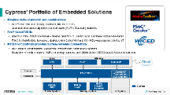
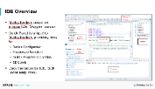
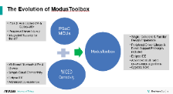
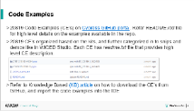
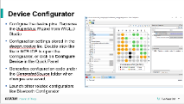
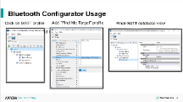
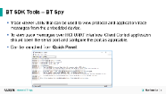
ModusToolbox Introduction – Agenda
Information in Chapter 1….
Cypress’ capabilities
ModusToolbox evolved from WICED and PSoC Creator
IDE – modeled after Eclipse
Code Examples – embedded & GitHub
Device Configurators – visualizing development tasks
BT Spy – Debug and Analysis built in

Slide 5




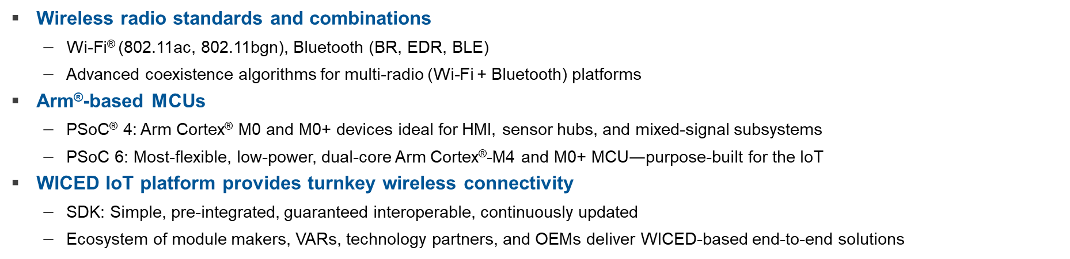
Cypress’ Portfolio of Embedded Solutions
Wireless radio standards and combinations
Wi-Fi® (802.11ac, 802.11bgn), Bluetooth (BR, EDR, BLE)
Advanced coexistence algorithms for multi-radio (Wi-Fi + Bluetooth) platforms
Arm®-based MCUs
PSoC® 4: Arm Cortex® M0 and M0+ devices ideal for HMI, sensor hubs, and mixed-signal subsystems
PSoC 6: Most-flexible, low-power, dual-core Arm Cortex®-M4 and M0+ MCU$—$purpose-built for the IoT
WICED IoT platform provides turnkey wireless connectivity
SDK: Simple, pre-integrated, guaranteed interoperable, continuously updated
Ecosystem of module makers, VARs, technology partners, and OEMs deliver WICED-based end-to-end solutions
Wired
Wireless
USB
Wi-Fi®
Bluetooth®
Sensors
PSoC® MCU
Capsense®
MagSense™
LCD Graphics
UI System
Actuators
Power System
Memory System
Analog/ PMIC
NOR &
Flash
SRAM F-RAM™
NVSRAM
Cypress
Notes:
>>Manual Section 1.1 Tour of ModusToolbox IDE
High level overview of Cypress products and major IDE tools
Take-Aways:
Cypress has three product lines: Connectivity; Processing; Memory
Cypress has three IDEs: PSoC Creator; WICED; ModusToolbox

Slide 6
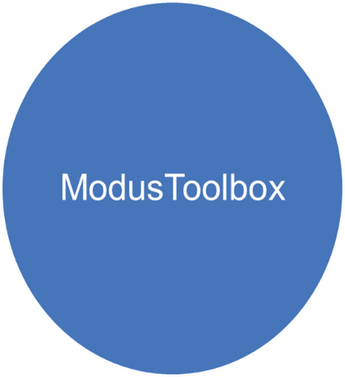

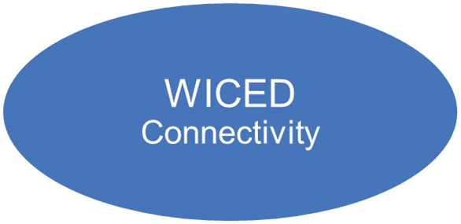
The Evolution of ModusToolbox
PSoC6: Arm Cortex-M4 & Cortex-M0+
Peripheral Driver Library
Integrated Security for the IoT
PSoC MCUs
Single, Coherent & Familiar Design Experience
Peripheral Driver Library & Board Support Packages included
Eclipse IDE
Advanced multi-radio co-existence algorithms
Cypress SDK
Wi-Fi and Bluetooth APIs & Drivers
Simple Cloud Connectivity
Eclipse IDE
Advanced Co-existence
Notes:
>>Manual Section 1.1 Tour of ModusToolbox IDE
Background history of ModusToolbox
Take-Aways:
1) ModusToolbox combines features from PSoC Creator and WICED into an updated Eclipse IDE.

Slide 7
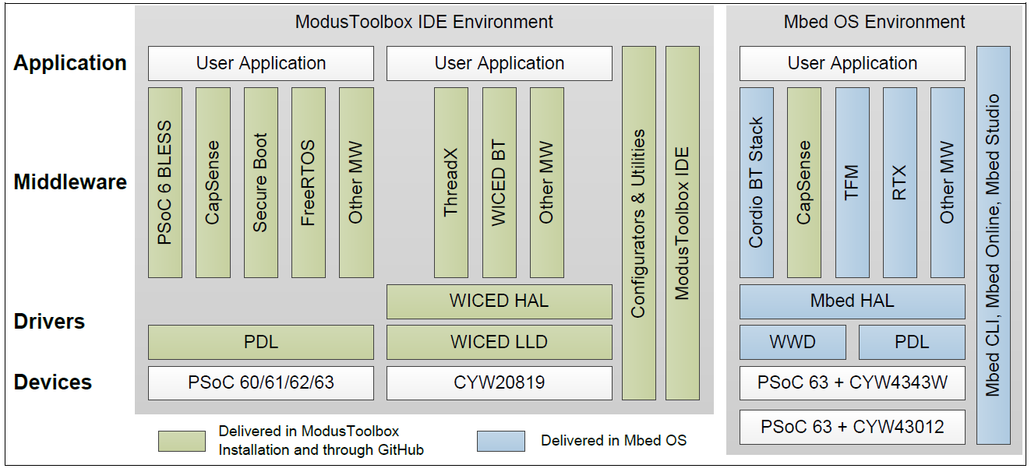

ModusToolbox 1.1 SDK View
ModusToolbox™ software is a set of tools that enable you to integrate Cypress devices into your existing development methodology
Notes:
>>Manual Section 1.1 Tour of ModusToolbox IDE
Take-Away: Modus is much more than the capabilities we’ll be showing today
Reference Section 1 Introduction from ModusToolbox IDE User Guide Rev *A

Slide 8
Pre-requisite
ModusToolbox - Intro
Load, Open and Understand Purpose & Capabilities of ModusToolbox
1. Start at https://community.cypress.com/welcome
2. Go to "Wireless", "ModusToolbox Bluetooth" and download the latest ModusToolbox from the Downloads table.
3. Find the appropriate version of ModusToolbox (Windows/Linux/macOS) @ https://www.cypress.com/products/modustoolbox-software-environment
4. Reference “ModusToolbox Installation Guide” found in the ‘Documentation’ tab @ https://www.cypress.com/products/modustoolbox-software-environment
ModusToolbox

Slide 9
Pre-requisite
ModusToolbox - Intro
Open and Browse Capabilities of ModusToolbox
1. . Run ModusToolbox IDE and create a new workspace.
6. Select the Documents tab in the lower-left panel.
7. Explore the different documents available:
ModusToolbox IDE Help
Quick Start Guide
User Guide
Eclipse IDE Survival Guide
WICED API Reference
ModusToolbox

Slide 10
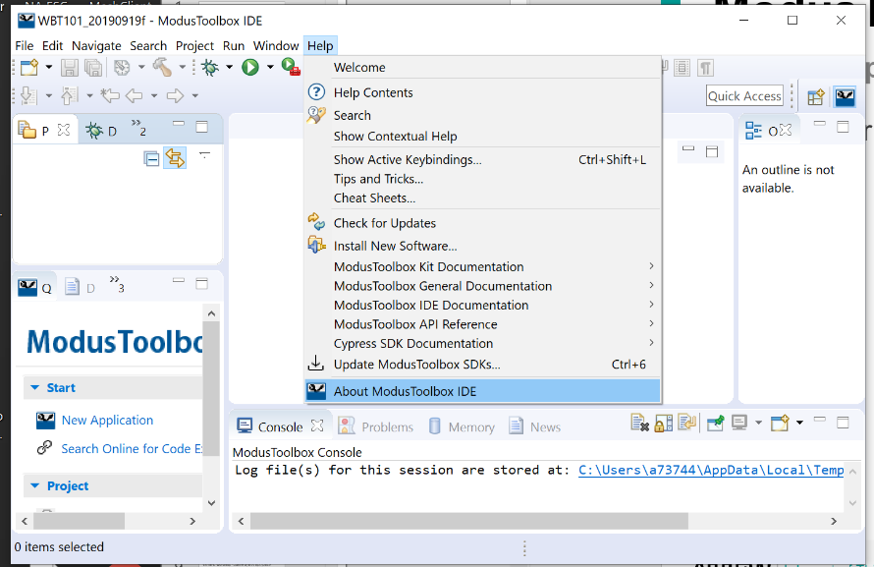
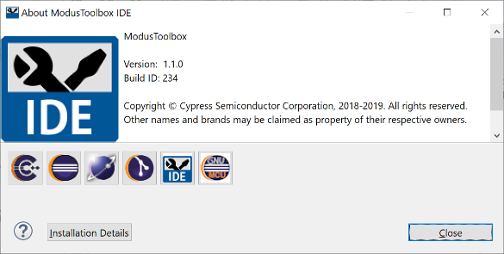
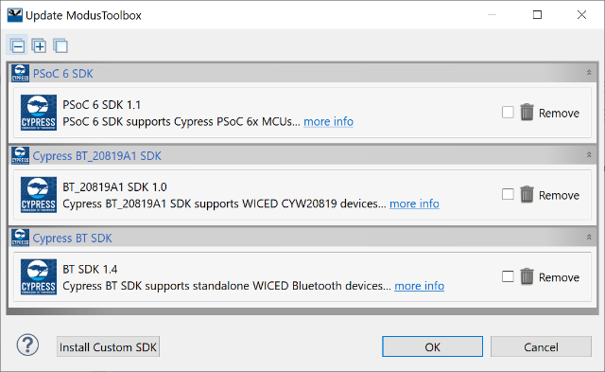
Pre-requisite
ModusToolbox - Intro
Verify or Update Versions
8. Verify correct Versions in Help drop-down
9. The “About ModusToolbox IDE” selection displays the version of the top level tool.
ModusToolbox
10. The “Update ModusToolbox SDKs..” selection displays the version of underlying modules.

Slide 11
Pre-requisite
ModusToolbox - Intro
Open and Browse Capabilities of ModusToolbox
11. After clicking "Help > Update ModusToolbox SDKs…"
12. Click "OK" if you see a message that says "Unable to find installable SDKs,…".
13. Find the latest BT-SDK @
https://community.cypress.com/community/modustoolbox-bt-sdk
14. If the latest version of the SDK is not already installed, Click "Install Custom SDK" and browse to the location of the SDK file to install the latest version.
15. Optional: You can uninstall any older version(s) of the BT SDK if desired.
ModusToolbox

Slide 12
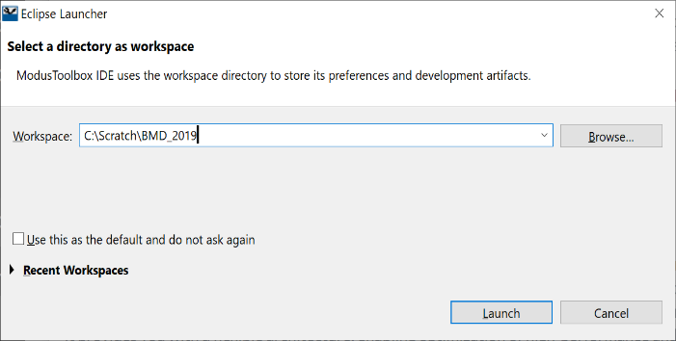
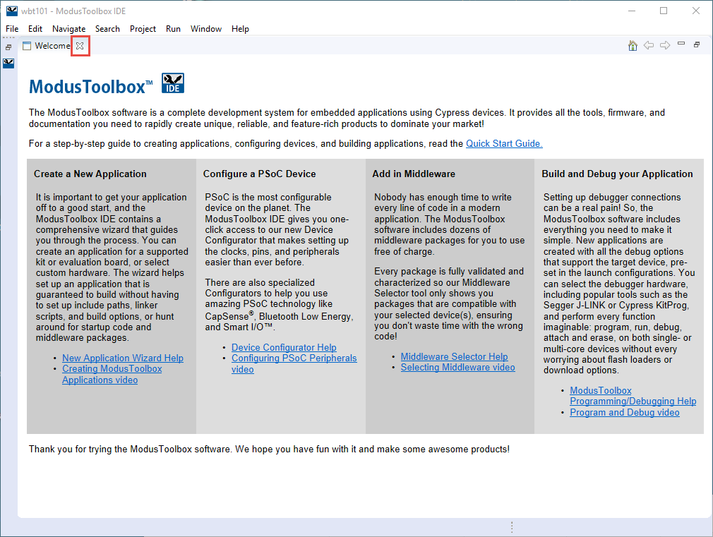
Hands-On – Use your PC when there’s a Bar ➔
Open Modus / Select Workspace / Opening Slide
Start Modus
Windows – Start Menu find “ModusToolbox x.x” ← Select the highest version
iOS
Linux
Select or accept the Workspace – then Launch
Observe Welcome screen – then click the “X”
ModusToolbox
Notes:
>> Manual 1.1.1 First Look
Take-Aways: Workspace location is flexible. Welcome screen give quick overview.

Slide 13
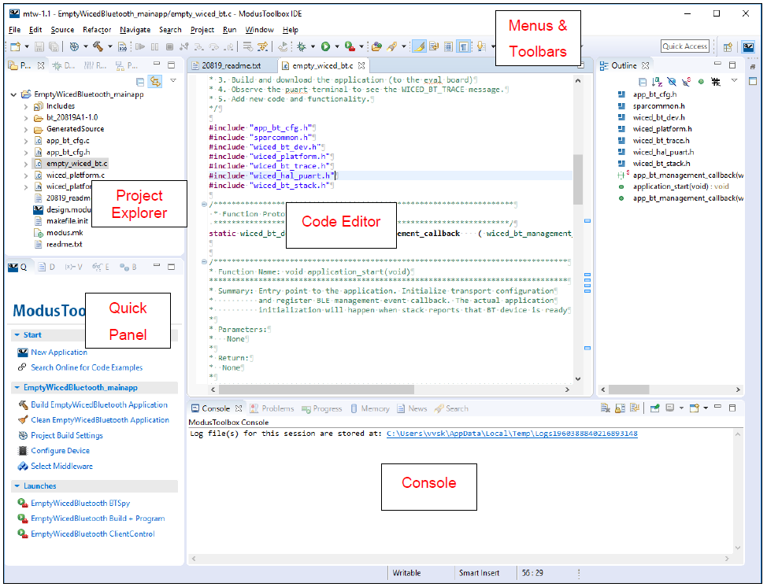
IDE Overview
ModusToolbox based on Elcipse IDE “Oxygen” version
Quick Panel is unique to ModusToolbox, providing links for
Device Configurator
Middleware Selection
Build + Program application
SDK tools
Documentation for IDE, SDK under Help menu
Outline
Notes:
>> Manual 1.1.1 First Look
Reference Section 4. IDE Description from Modus Toolbox IDE User Guide Rev *A
Take-Aways: ModusToolbox modeled after Eclipse. Quick Panel adds links to documentation and Cypress Custom Features such as Device Configurator

Slide 14
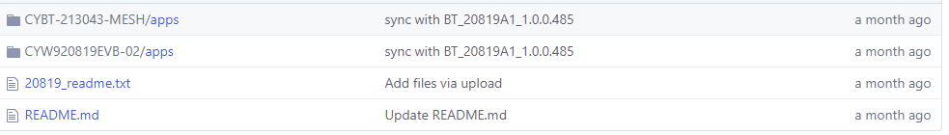
Code Examples
20819 Code Examples (CE’s) on Cypress GitHub portal. Refer README.md file for high level details on the examples available in the repo.
20819 CE’s organized based on the kits, and further categorized in to snips and demos like in WICED Studio. Each CE has readme.txt file that provides high level CE description.
Refer to Knowledge Based (KB) article on how to download the CE’s from GitHub, and import the code examples into the IDE
GitHub
Notes:
Take-Aways: Examples have been developed
Ref Section 1.1.7 Sharing Applications
Improve this slide by describing what files are required,
how to Archive, various ways to retrieve
Include path names to Arrow’s GitHub
Don’t use HotLinks

Slide 15
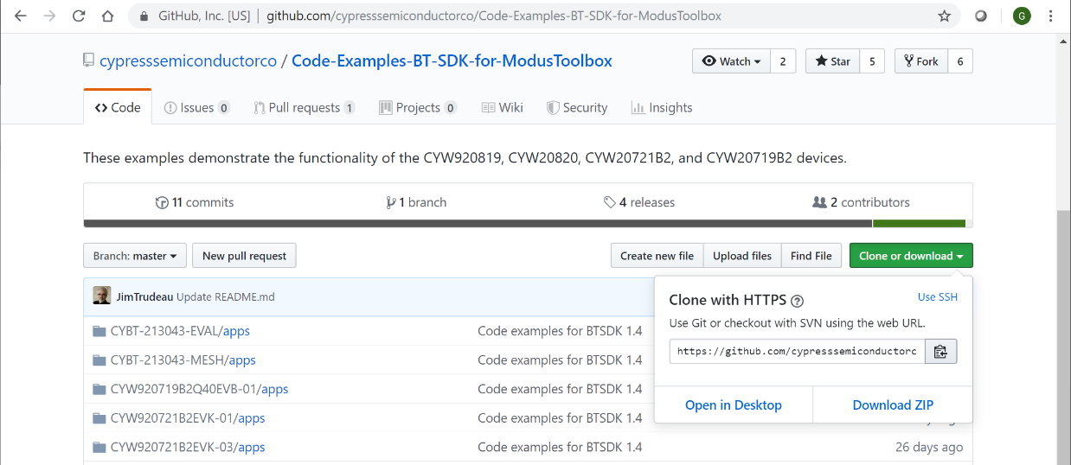
Copy Code Examples
ModusToolbox
From “Quick Panel”, Search Online for Code Examples
Scroll down to find then select Bluetooth SDK Examples
Select the green box Clone or download then Download ZIP
Unzip files to a directory on your PC.
GitHub
Notes:
Go through pulling options of files from Arrow’s GitHub

Slide 16
Open Imported Code Examples from your PC
Click New Application in Quick Panel
-or- File > New > ModusToolbox IDE Application
Select your Target Kit = CYW920819EVB-02 then Next
Click Import
Navigate to the location on your PC where Examples were copied or downloaded. Find and Open the file modus.mk within the selected Example.
ModusToolbox
Notes:
Import those projects pulled from GitHub

Slide 17
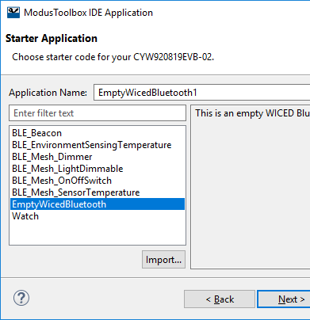
Open Empty Application
New applications rely on templates with modus.mk and select source files.
Launch New Application wizard
Select the Target Hardware CYW920819EVB-02
Select template application EmptyWicedBluetooth
Be Patient – it may take some time to setup.
ModusToolbox
Notes:
Take-Aways: A new application can be created from an example in Modus, imported from GitHub or from an existing file on your PC.

Slide 18
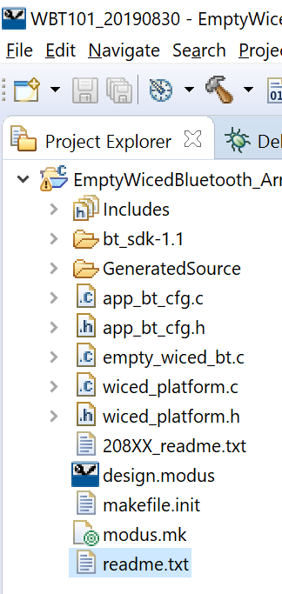
Project Explorer View
Includes folder – Contains header files related to the BT stack, HAL, hardware platform
bt_20819A1-1.0 folder – Contains additional source files. spar_setup.c inside the folder contains the startup code.
GeneratedSource folder – Files related to design configuration – Hardware resource configuration (Pins, Peripherals, clocks) generated by Device Configurator, and the BLE GATT Database files generated by Bluetooth Configurator
design.modus file - Graphical configurator design file that contains hardware resource configuration settings. This file is used by the graphical configurators, which generate/modify the configuration firmware in the GeneratedSource folder.
Notes:
Take-Aways: All files utilized by the project are listed in the Project Explorer window.
Includes are used as is – don’t modify these
bt_20819… are platform specific ← say something more about these
GeneratedSource created by ModusToolbox – not recommended to modify these

Slide 19
Project Explorer View
empty_wiced_bt.c file – Contains the application_start() function, which is the entry point for the user application code execution after device startup
app_bt_cfg.c and app_bt_cfg.h files contain the runtime Bluetooth stack configuration parameters like device name, and advertisement/connection settings.
wiced_platform.c, wiced_platform.h files contain the functions and macro definitions related to the initialization of the kit, including the LEDs, buttons, and sensors used on the kit.
modus.mk file is the top-level Makefile that describes the design, and is created and used by the IDE. It contains the design make variables that are passed to the build system. This file is modified by the IDE during certain operations like changing Application Settings or Middleware Selection.
Notes:
Take-Aways:
modus.mk is the main file created by ModusToolbox IDE to describe the project. Within this file, CY_APP_SOURCE points to the order of key files.
For the EmptyWicedBluetooth example, empty_wiced_bt.c is the main file
app_bt_cfg.c and .h are user configurations for Bluetooth
wiced_platform.c and .h initialize features of the specific platform

Slide 20

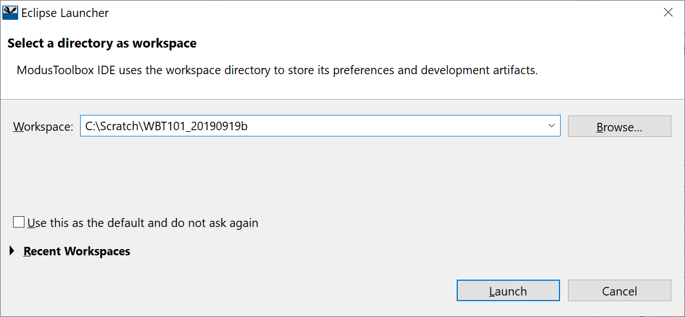
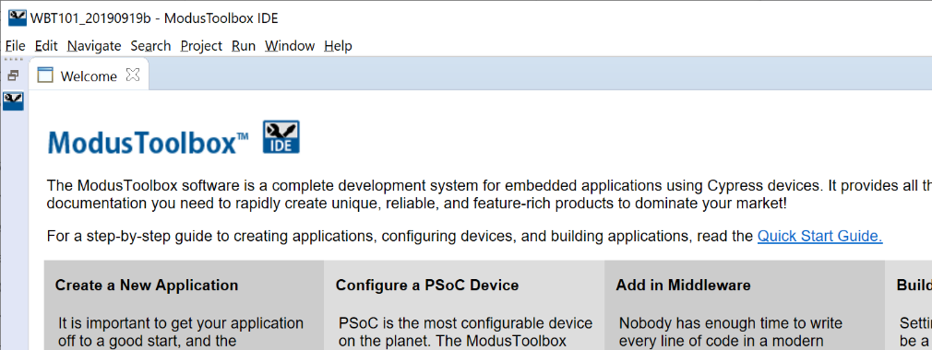
Exercise Ch1 → Open Modus Toolbox
Purpose: Create an application to blink LED_1 on the kit at 2 Hz.
Reference: Section 3.4.1 GPIO in Peripherals
1. Open ModusToolbox
2. Select a directory as workspace
3. Click Launch
ModusToolbox
4. Click “X” in the “Welcome” tab for ModusToolbox introductory screen if it pops up

Slide 21
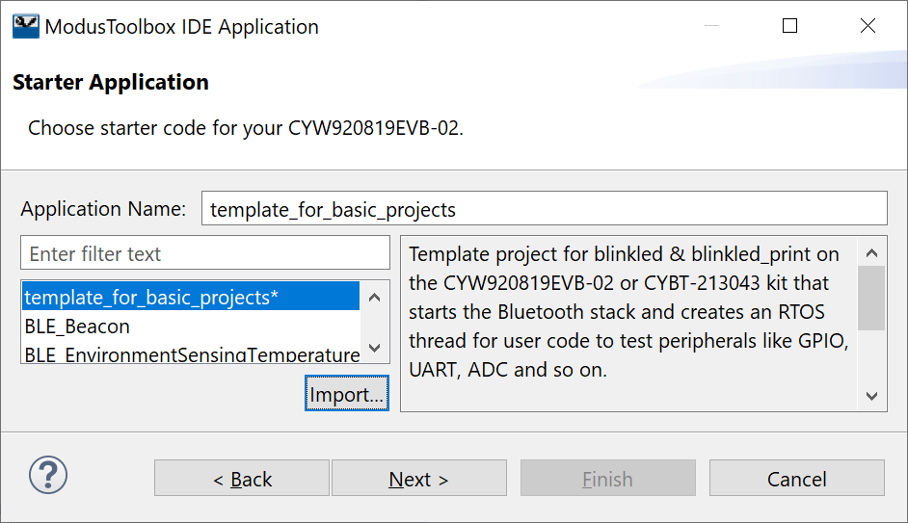
Exercise Ch1 → Blink an LED
Purpose: Create an application to blink LED_1 on the kit at 2 Hz.
Reference: Section 3.4.1 GPIO in Peripherals
1. In the Quick Panel click New Application
2. Select the target kit
CYW920819EVB-02
-or-
CYBT-213043-MESH
3. Press Next >
4. Press the Import…
5. Navigate to course materials in “Template/ch01"
6. Double-click on modus.mk
Be patient while the project imports.
7. When complete the example will show in the Application Name box and list of Applications
ModusToolbox

Slide 22
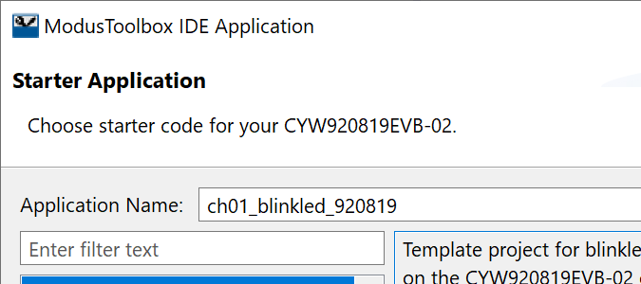
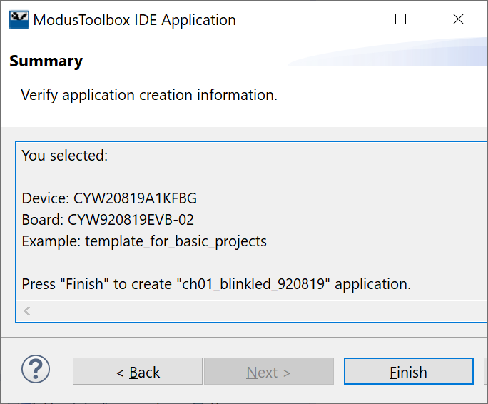
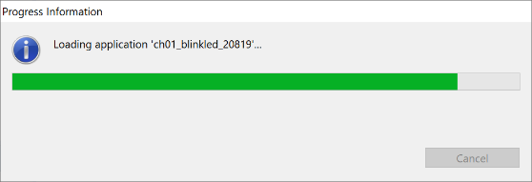
Exercise Ch1 → Blink an LED (cont’d)
8. Change the Application name to designate your kit.
Note: Being able to differentiate which projects are for which kits will be critical when programming Mesh devices on different platforms.
9. Click "Next ". Verify the Device, Board, and Example
10. Click "Finish“ then wait….
ModusToolbox

Slide 23
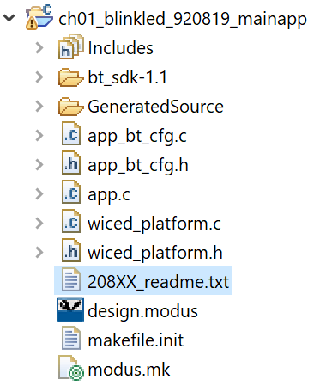
Exercise Ch1 → Blink an LED (cont’d)
11. Verify the Project Explorer window in Eclipse looks similar the example here
Notes:
Sub-directory “bt_sdk-1.1”, will reflect the latest SDK loaded
File “208XX_readme.txt”, reflects the selected platform
ModusToolbox

Slide 24
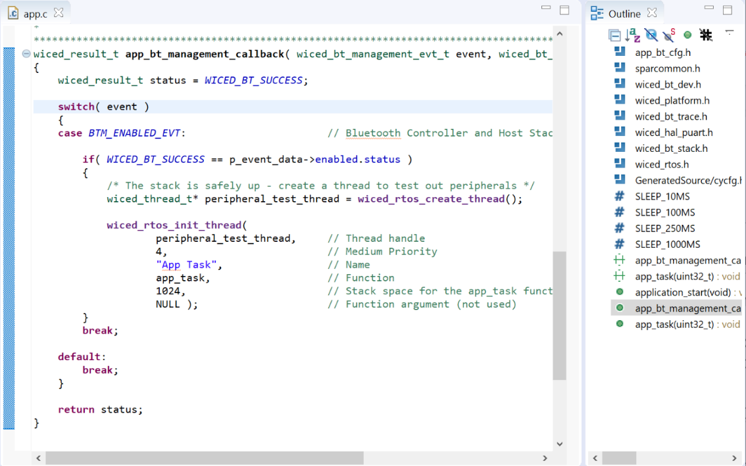
Exercise Ch1 → Blink an LED (cont’d)
12. Examine app.c to make sure you understand what it does.
Note: The Outline window provides a summary of the code.
All WICED BLE applications are multi-threaded (the BLE stack requires it).
An RTOS launched from the device startup code can be used to create custom threads.
Each thread has a function that runs almost as though it is the only software in the system – the RTOS allocates time for all threads to execute when they need to. This makes it easier to write your programs without a lot of extra code in your main loop.
Details of how to use the RTOS effectively are NOT a focus of this workshop. Additional information on RTOS is available in Cypress’ full workshop.
ModusToolbox

Slide 25
Exercise Ch1 → Blink an LED (cont’d)
13. Add code in the app_task thread function to do the following:
a. Read the state of WICED_GPIO_PIN_LED_1
i. Note: GPIO interaction will be explained in Chapter 3
-or-
Open WICED API Reference in the Documentations tab in bottom left window
Navigate to Components / Hardware Drivers / GPIO to find optional commands
ii. Hint: To find the appropriate pin, search for the platform file. Look in “Includes” directory.
wiced_platform.h under CYW920819EVB_02 describes pin mappings for the demo kit
- and –
Find the kit schematics by searching for CYW920819EVB-02_SCHEMATIC on your PC.
Note: Schematics may be within the CYBT_213043 files.
b. Drive the state of WICED_GPIO_PIN_LED_1 to the opposite value.
ModusToolbox
Notes:
User Button SW3 connects to P00
LED1 = D1 Yellow via SW4 = P27
LED2 = D2 Red via SW4 = P26
Note in wiced_platform.h:
/*! pin for button 1 */
#define WICED_GPIO_PIN_BUTTON_1 WICED_P00
#define WICED_GPIO_PIN_BUTTON WICED_GPIO_PIN_BUTTON_1
/*! pin for LED 1 */
#define WICED_GPIO_PIN_LED_1 WICED_P27
/*! pin for LED 2 */
#define WICED_GPIO_PIN_LED_2 WICED_P26

Slide 26
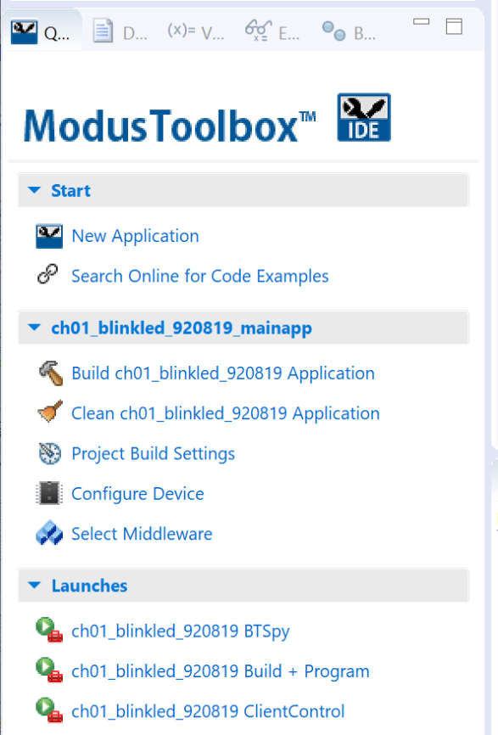
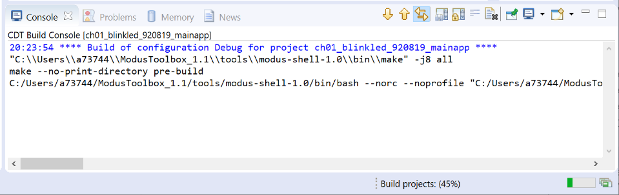
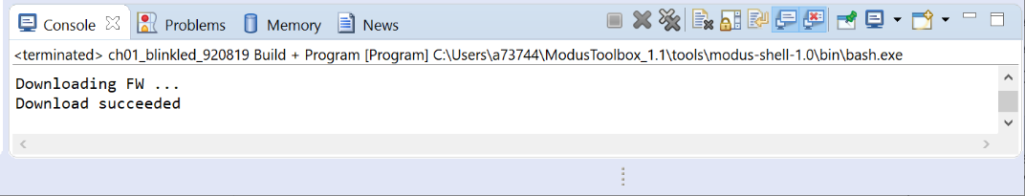
Exercise Ch1 → Blink an LED (cont’d)
14. In the Quick Panel, look in the "Launches" section and press the "ch01_blinkled_20819 Build + Program" link.
Note: Progress is tracked in Console & lower right corner.
15. Once the build and program operations are done, you should see "Download succeeded" in the Console window and LED1 (yellow user LED) should be on and blinking.
ModusToolbox
Notes:
User Button SW3 connects to P00
LED1 = D1 Yellow via SW4 = P27
LED2 = D2 Red via SW4 = P26
Note in wiced_platform.h:
/*! pin for button 1 */
#define WICED_GPIO_PIN_BUTTON_1 WICED_P00
#define WICED_GPIO_PIN_BUTTON WICED_GPIO_PIN_BUTTON_1
/*! pin for LED 1 */
#define WICED_GPIO_PIN_LED_1 WICED_P27
/*! pin for LED 2 */
#define WICED_GPIO_PIN_LED_2 WICED_P26

Slide 27
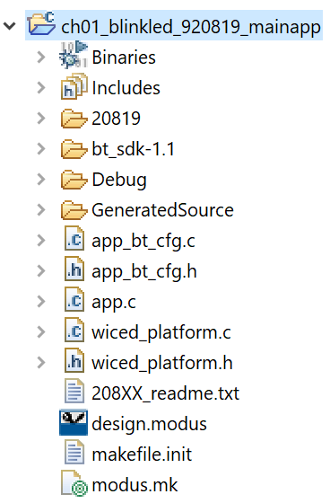
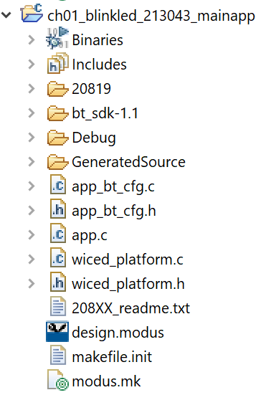
Exercise Ch1 → Blink an LED (cont’d)
Note: After Build and Program, additional directories are created for the underlying component “20819” and “Debug”
ModusToolbox
Notes:
User Button SW3 connects to P00
LED1 = D1 Yellow via SW4 = P27
LED2 = D2 Red via SW4 = P26
Note in wiced_platform.h:
/*! pin for button 1 */
#define WICED_GPIO_PIN_BUTTON_1 WICED_P00
#define WICED_GPIO_PIN_BUTTON WICED_GPIO_PIN_BUTTON_1
/*! pin for LED 1 */
#define WICED_GPIO_PIN_LED_1 WICED_P27
/*! pin for LED 2 */
#define WICED_GPIO_PIN_LED_2 WICED_P26

Slide 28
Exercise Ch1 → Blink an LED (cont’d)
Example of Code to Blink an LED
if( GPIO_PIN_OUTPUT_HIGH == wiced_hal_gpio_get_pin_output( WICED_GPIO_PIN_LED_1 ) )
{
wiced_hal_gpio_set_pin_output( WICED_GPIO_PIN_LED_1, GPIO_PIN_OUTPUT_LOW );
}
else
{
wiced_hal_gpio_set_pin_output( WICED_GPIO_PIN_LED_1, GPIO_PIN_OUTPUT_HIGH );
}
ModusToolbox

Slide 29
Intro to ModusToolbox – Summary
Newest of Cypress’ Integrated Design Environments
ModusToolbox is an Eclipse-based IDE
Comprises unified Cypress SDK that is IDE agnostic and merges the PSoC MCU libraries and the WICED wireless libraries
Combines PSoC Creator and WICED features and workflows into a single product catering to MCU and IoT products
Supports both programming and debugging through OpenOCD and Segger
WICED7 integration into combined SDK
BT Designer Integration
Code Examples Embedded and in GitHub
Embracing GitHub as the primary distribution mechanism for Example code
Distributing more examples through SDK to use offline.

Slide 30
Take-Aways – ModusToolbox – Class Questions
List five different ways to obtain information on commands in ModusToolbox
List three ways to identify features of a specific chip targeted in ModusToolbox
Notes:
Answers:
List five different ways to learn what commands can be used Modus
→ Examples in Modus and GitHub; Documents section of ModusToolbox; Help dropdown in ModusToolbox; Autofill features (may need to enable autofill ??); Hover over and Highlight & Right-Click on commands in ModusToolbox;
2) List three ways to identify features of a specific chip targeted in Modus
xxx_platform.c and xxx_platform.h files; Search for part documentation @ Cypress.com; Platform information for SDK @ <Installation_Directory>\ModusToolbox_1.1\libraries\bt_20819A1-1.0\components\BT-SDK

Slide 31
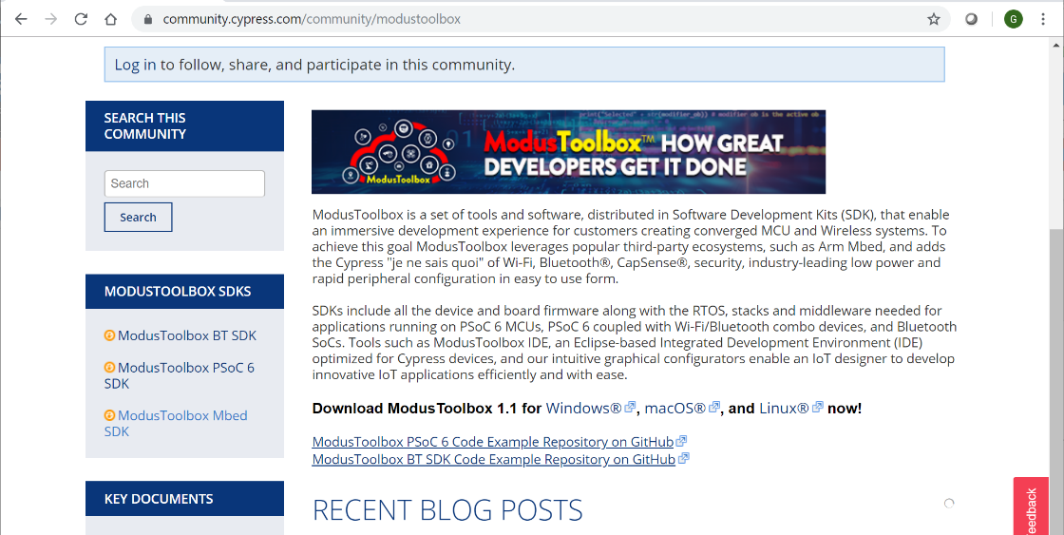
Tips & Tricks
Stay updated with latest version of ModusToolbox and SDKs
https://community.cypress.com/community/modustoolbox

Slide 32
References
Documents Section of Quick Panel
“ModusToolbox Documentation Index” in the Documents section of the Quick Panel has brief descriptions and links to a variety of support documents
“WICED API Reference” provides descriptions of software commands.
ModusToolbox™ Software Environment
@ https://www.cypress.com/products/modustoolbox-software-environment
Documentation tab lists a majority of ModusToolbox links
Cypress Developer Community Video Library @ https://www.cypress.com/video-library/PSoC-Software/welcome-modustoolbox-1-creating-new-applications/606471

Slide 33
Introduction to Cypress BLE Mesh
Greg Carson, Mike Roberts, Victoria Bohanna Pea
Reference: BLE-Mesh-02-Tour-ModusToolbox 2019

Slide 34
Cypress BLE-Mesh Introduction – Agenda
Information in Chapter 2….
BLE-Mesh Evolution
Relay, Low-Power, Friends and Proxies
Mesh Security
Technical Comparison
Available Products

Slide 35
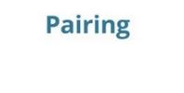
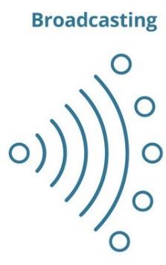

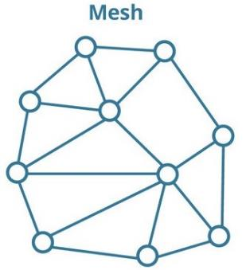
Bluetooth Mesh
Adopted in July 2017
Separate stand-alone profile specification, together with “Models” and “Properties”
Not a part of Bluetooth Core Specification
1st generation of BLE-connected smart home products (1:1 or 1:n)
1st generation products limited to 1:1 or 1:n direct communication
Evolution of BLE Mesh (n:n)
Extends range by relaying messages from one node to another
Full stack makes products from various vendors interoperable
Direct smartphone Communication – no Bridge/Hub
True Mesh enabled Home Automation
Enables a true n:n Mesh connected network that links all nodes
Long battery life for products that leverage low power feature

Slide 36
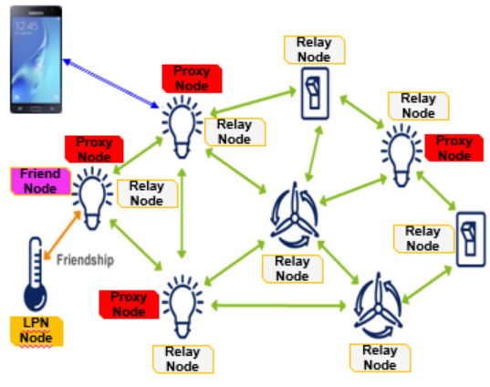
Example of a Home BLE Mesh Network
Relay Nodes
Light Switches, Light Bulbs, HVAC Controls
Low Power Node (LPN)
Temperature Sensor, sleeps between measures, and then sends its measures to the network
Friend Node
Light Bulbs
Establishes a friendship with a LPN
Saves messages meant to go to the LPN
When polled, sends saves messages to LPN
Proxy Node
Light Bulbs
GATT connection to a mobile or tablet used to
Control, Monitor & Provision nodes
OTA FW image upgrade

Slide 37
Security includes Keys Sequencers and Records
Network Key given to All nodes in mesh network
App Keys secure messages for specific applications, i.e. lighting, heating, etc
Device Key is used to provision and configure each node
Privacy Keys hide message source information
Subnet Keys allow groups to exist within networks
Two network PDU fields protect against Replay Attacks
Sequence Number (SEQ)
IV Index an extension to SEQ
De-commissioning protects against Garbage Can Attacks
Notes:
Examples of layered security…
A light bulb mesh node is expected to relay all messages irrespective of the origin message
A light bulb node has no business accessing and processing the details of a smoke detector message
A Privacy Key derived from the Network Key is used to hide network header values (SRC address)
This ensures that interceptors cannot be used to track nodes and/or the people using them
Sequence Number (SEQ) is increased by elements every time they publish a message
IV Index is a field alongside SEQ that must be >= than the last valid element message
When disposing or selling a node to a 3rd party, it’s important that the device’s keys it contains can’t be used to break into your network
A procedure for removing a node from a network is defined
The provisioning app adds the node to a black list and triggers the Key Refresh Procedure

Slide 38
Debugging the Myth of BLE-Mesh
Power Consumption is managed
BLE mesh is designed to support nodes needing to operate for several years on a battery (Friend Nodes)
BLE mesh is more than Flood
The “managed part of the flood” is often missed… but it makes the whole difference! Sub-networking, Time-To-Live, node grouping via virtual addresses, …
Acknowledged messages are manageable to groups
When commands requiring ACK responses are issued to a group of nodes, the nodes use a random timer delay before responding. Along with a command repetition mechanism, random delays ensure the controller is unlikely to miss a node ACK notification
BLE mesh has mechanisms for OTA FW upgrade
SIG Mesh working group released an OTA standard in Q4CY18

Slide 39
BLE Mesh Advantages Over Other Mesh Technologies
1 | OSI Model – Full Stack Implementation
2 | Radio – Established technology in billions of devices
3 | Wireless Interference – Single Channel vs 3 Channels
4 | Range – 300 meters to 1 km
5 | Data Rate – Up to 2 Mbps
6 | Shorter Packets – 29 octets
7 | Power Consumption / Duty Cycle
8 | Interoperability / Certification
9 | Compatibility with Smartphones and Tablets
10 | Cost

Slide 40
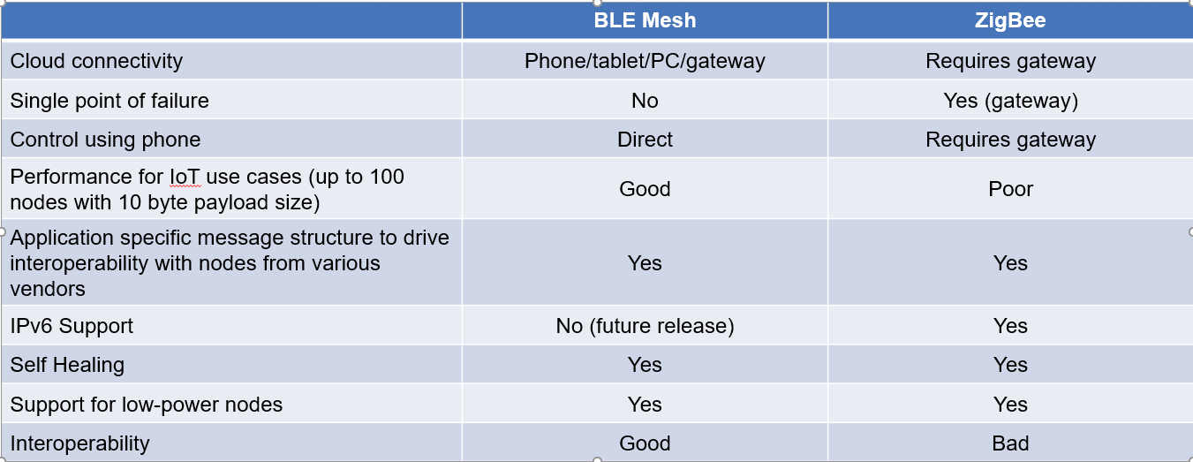
BLE Mesh vs Other Mesh Technologies

Slide 41
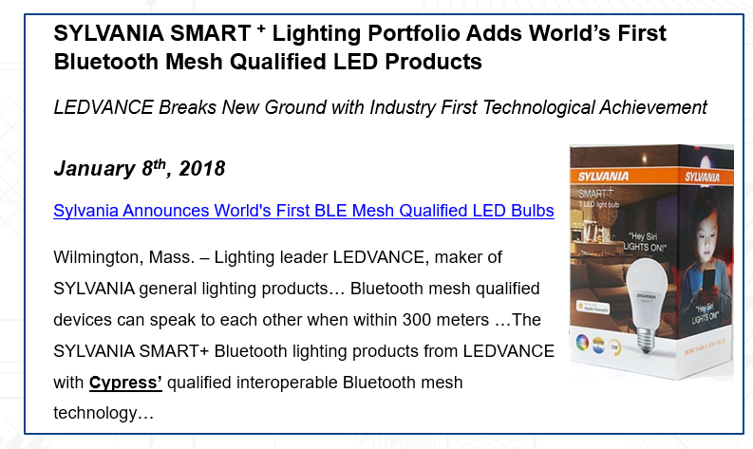
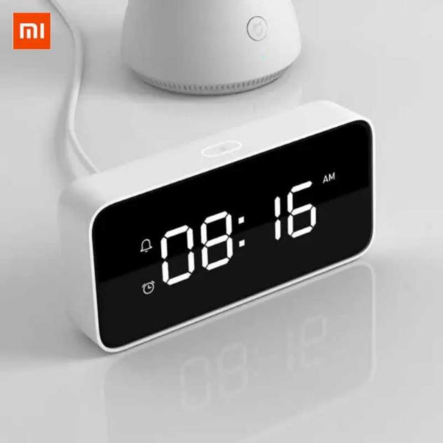
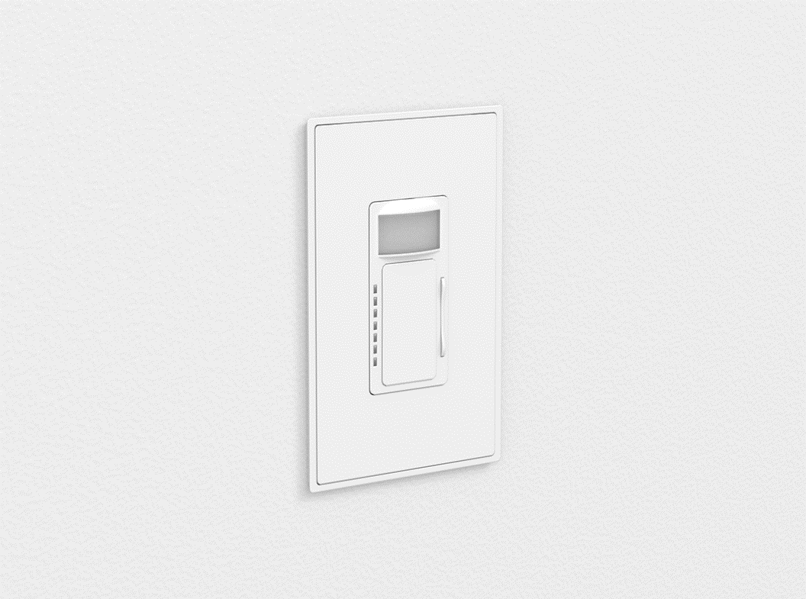
BLE Mesh as a Foundation to Deploy Value-add Services
BLE Mesh at home enables deployment of value-add services
Home presence detection
Geo-fencing
Tracking & finding valuable goods
BLE mesh seamlessly connects different home devices and allows direct control from anywhere in home
Smart locks
Smart light bulbs and controls
Smart appliances
Notes:
Xiami AI Smart Clock
BubblyNet Mesh wall mounted switch and occupancy sensor

Slide 42
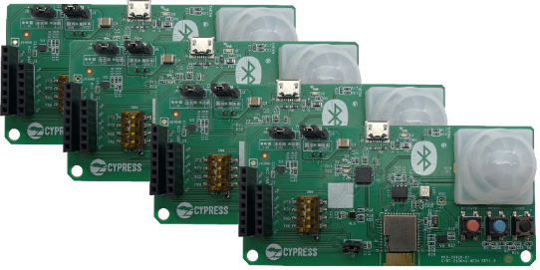
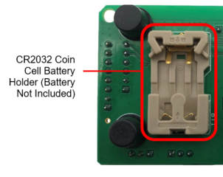
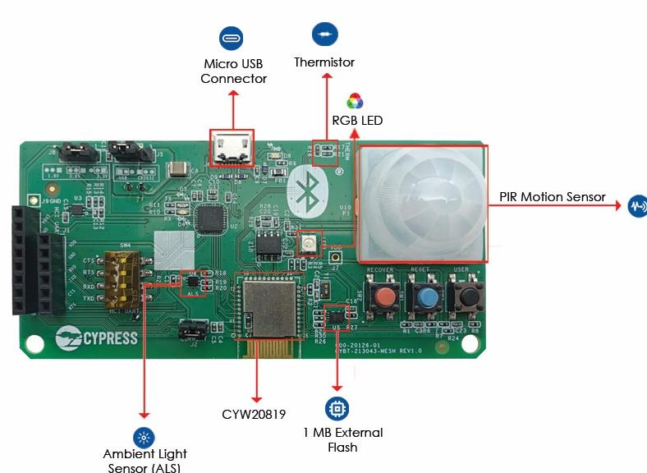
CYBT-213043-MESH BLE Mesh Evaluation Kit
Kit includes
4 BLE Mesh node boards
Each BLE Mesh node board showcases
CYW20819-based certified module, CYBT-213043-02
RGB LED and user buttons
Ambient light, thermistor, and PIR motion sensors
Current measurement header
On-board programmer
Provides great out-of-the-box user experience
Several code examples, provided in SDK and GitHub, are developed for this kit
Cypress iOS, Android, or Windows helper Mesh applications can be used to provision these boards, create and control mesh network quickly and easily
Four boards in the kit
Board bottom side
Board top side

Slide 43
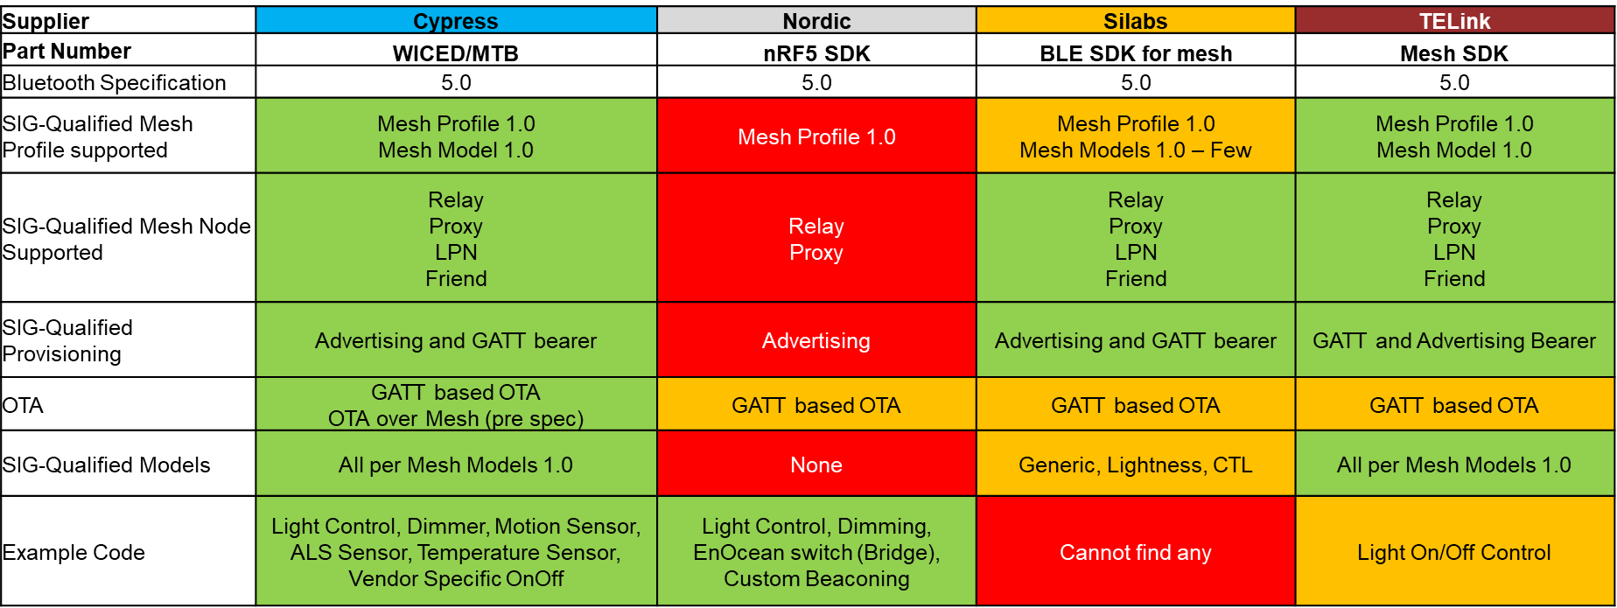
Competitive Analysis – Mesh Standard Support
Notes:
Historic information – needs update

Slide 44
References
BT SIG @ https://www.bluetooth.com/
Intro: https://www.bluetooth.com/blog/introducing-bluetooth-mesh-networking/
Modules: https://www.cypress.com/products/ble-mesh
Specification: https://www.bluetooth.com/specifications/mesh-specifications/
Security: https://www.bluetooth.com/blog/bluetooth-mesh-security-overview/

Slide 45
BLE-Mesh – Peripherals
Greg Carson, Mike Roberts, Victoria Bohanna Pea
Reference: BLE-Mesh-03-Tour-ModusToolbox 2019
Notes:
Aligns with BMD-03-Revxx-Peripherals.docx
Aligns with portion of WBT101-01-Tour from GitHub https://github.com/iotexpert/WBT101
Portions from file found linked to Documentation tab of https://www.cypress.com/products/modustoolbox-software-environment. (ModusToolbox documentation can be found on the web per the above link or in ModusToolbox in the Documentation section)
ModusToolbox™ IDE User Guide Rev *A @ https://www.cypress.com/file/455211/download
ModusToolbox™ IDE Quick Start Guide Version 1.1 @ https://www.cypress.com/file/455221/download
Eclipse IDE Survival Guide KBA225399 Rev *H @ https://community.cypress.com/docs/DOC-15617

Slide 46
Peripherals – Agenda
Intro to Peripherals
What’s available on a specific package
Methods to interface with peripherals
Status on Interacting with peripherals (WICED_RESULT_T)
Exercise
Notes:
>> Manual Section Table of Contents

Slide 47
Peripherals – I/O capabilities of BLE-Mesh MCUs
Peripherals include
Communication interfaces: UART (HCI & P) , I2C and SPI
Functions: Timers, PWM, NVRAM, ADC & RTC
Configurable pins: GPIO
Peripherals allow
Machine to Machine: I/O to send messages
Complex functions: Generate messages and measure sensor levels
Human Machine Interface: Access to indicators such as LEDs to illuminate and blink
Peripheral control
Device Configurator is a graphical tool that extends features of the Board Support Package (BSP), for example by choosing to drive an LED from a PWM instead of firmware.
Notes:
>> Manual Section 3.1 Introduction to Bluetooth SoC Peripherals
Be aware, though, that the WICED example apps and snips predate the availability of the configurator and often rely on firmware-only configuration. As a result, you cannot assume that a peripheral or GPIO that is disabled in the configurator is not actually in use by the application. As ModusToolbox and its associated examples mature you will see a greater utilization of the configurator-generated code and more powerful set of configuration options (e.g. PWM duty cycle and UART baud rate).

Slide 48
Peripherals – Specific for a given platform
Board Support Package (BSP) is a collection of files that specify which device is on the board, how it is programmed, what peripherals are available, which pins they are mapped to, etc.
Every kit has exactly one BSP
For custom hardware, either create a new BSP (beyond the scope of this course) or create an application with the BSP that most closely matches the hardware then modify the files as necessary.
design.modus is a database for the Device Configurator
cycfg_pins.c contains arrays of constants to configure and initialize peripherals
wiced_platform.h contains #define and type definitions to set up and access various kit peripherals
Notes:
>> Manual 3.2 Board Support Package

Slide 49
Peripheral – Interface Method
High-Level Steps to utilize peripherals will be the same:
Initialize
Stating intention to use a peripheral loads the required functions into project code for use.
Example: #include “<peripheral code base.h>”
Configure
Setup the peripheral interface basic features
Example: wiced_hal_peripheral_speed (400KHz);
Access
Use the peripheral as a common interface
Example: wiced_hal_peripheral_write(<data>, <size>, <destination>);
Note: Some peripherals, such as GPIO, are automatically pre-initialized. It doesn’t hurt to re-initialize.

Slide 50
Peripheral – Common Choices
Peripheral | Initialize (#include) | Configure | Access | Return Status
GPIO | wiced_hal_gpio.h | Direction, Bias, Trigger points, Connection … | Read, Write, Clear Interrupt…. | Failure, Success, Remapped or Moved
HCI UART | wiced_transport.h | Speed, Port, Bits…
P UART | wiced_hal_puart.h | Speed, Port, Bits…
Timer | wiced_timer.h
PWM | wiced_hal_pwm.h | Clock Source, Init & toggle values, … | Start, Stop, change value…
NVRAM | wiced_hal_nvram.h | Start and end points | Read, Write, Delete…
I2C | wiced_hal_i2c.h
ADC | wiced_hal_adc.h wiced_hal_adc_init | Input Range, Offset, Reference… | Read
RTC
P SPI
Notes:
Need to complete this slide…
** This slide should have each box with some information
Intent here is a quick reference on what each peripheral provides and how to use it.

Slide 51
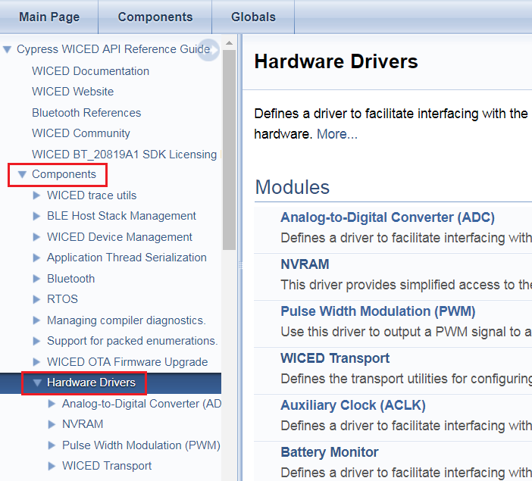
Peripheral – Interface Commands
Find “WICED API Reference”
under Documents tab (next to Quick Panel)
–or–
Help > ModusToolbox API Reference >
Investigate peripheral APIs under Components > Hardware Drivers
GPIO
Pulse Width Modulation (PWM)
Peripheral UART (PUART)
I2C
Real-Time Clock (RTC)
Peripheral SPI Driver
ModusToolbox
Notes:
>> Manual 3.3 Documenation
Intent here – showing how to use API Reference to find software commands to interact with peripheral

Slide 52
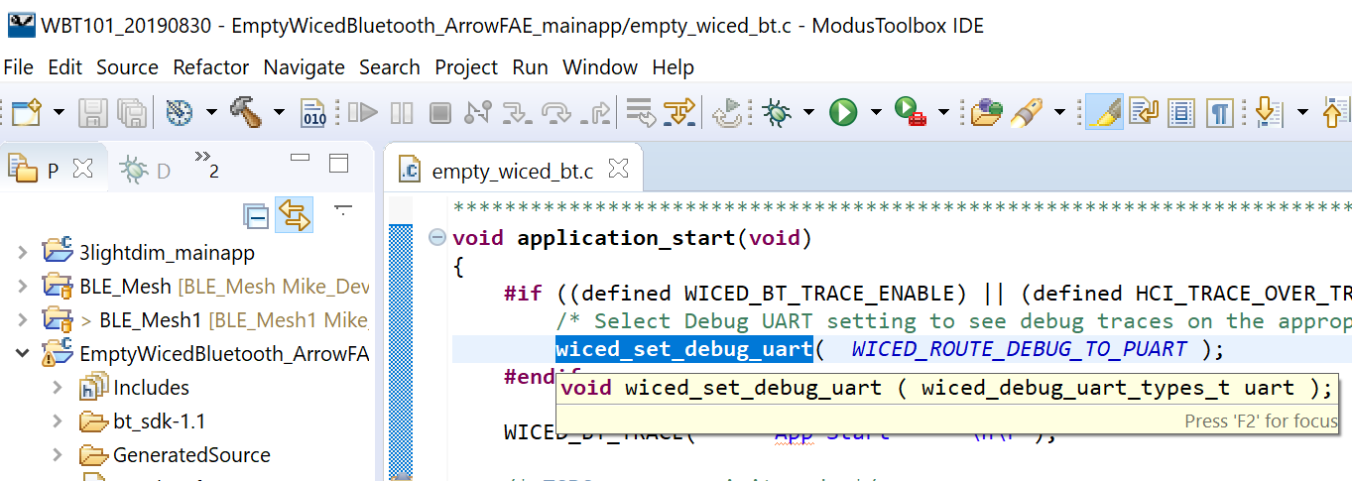
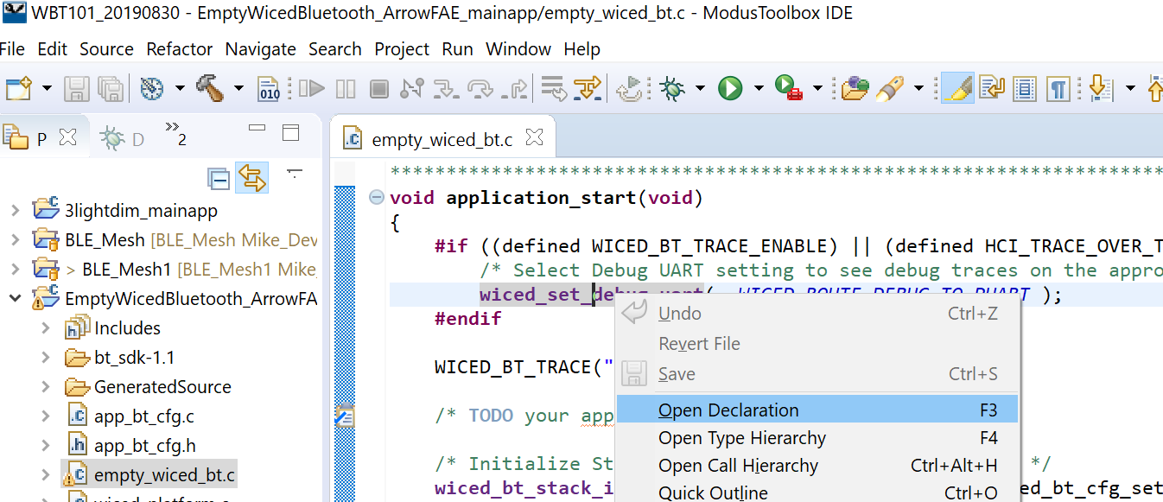
Active Coding Support
Hover over a function or variable → see a brief usage or value pop-up
Highlight a function in the C code; Right-click then select "Open Declaration" (F3) → open new window with definition
Start to type a command then press <ctrl> <space> for options.
ModusToolbox
Notes:
>> Manual 3.3 Documentation
Take-Aways: instant help on commands
Using example code shows suggestions on commands and approach. Hovering over those commands provides further explanation.

Slide 53

Peripherals – Device Configurator
Use to Configure Device Pins.
Configuration settings stored in the design.modus file.
Generates configuration code under the GeneratedSource folder when changes are saved.
Launch other related configurators like Bluetooth Configurator from Device Configurator
ModusToolbox
Notes:
MTB = ModusToolBox
Open Configurator by double clicking “design.modus”
Take-Aways = Design Configurator opens a GUI to hardware platform specific features

Slide 54

Peripherals – Device Configurator
In ModusToolbox “Quick Panel”
Find “Configure Device” under the current project
In the Device Configurator pop-up, select a Resource
Observe configuration options or a link to a Peripheral Configurator
ModusToolbox
Notes:
In addition to pure software control of peripherals, Cypress is developing pseudo wizards, they call Configurators for key peripherals. Additional configurators will be added in subsequent ModusToolbox and SDK updates.

Slide 55
Bluetooth Configurator
Generates the BLE GATT database for the application
Launch from Device Configurator, or as a stand alone utility from the installation folder (\\ModusToolbox_1.1\tools\bt-configurator-1.1\bt-configurator.exe)
Generated Files
cycfg_gatt_db.c and .h : Store GATT database info used in the application code
cycfg_bt.h : Stores information used by the Bluetooth configurator in xml format
Current version does not support Bluetooth Classic or GAP settings configuration
ModusToolbox
Notes:
Take-Aways: Bluetooth can be personalized with a configuration tool – similar to a wizard.
Bluetooth Configurator is evolving. Key functions have been implemented.

Slide 56



Bluetooth Configurator Usage
Click on GATT profile
Add “Find Me Target” profile
Final GATT database view
ModusToolbox
Notes:
Try it out
Take-Away: Cypress makes customizing BLE features easy

Slide 57



BT SDK Tools – BT Spy & Client Control
BTSpy – Trace Viewer Utility to receive, decode and display protocol application and stack trace messages.
ClientControl - Host app to communicate with the embedded app to perform various functionalities, tests, exercising features, etc.
Together they allow viewing trace messages over HCI UART interface.
Launched from Quick Panel.
Reference: “ModusToolbox IDE User Guide”
Notes:
Take-Aways: BT Spy can help to debug Bluetooth designs

Slide 58

Deeper Dive - Debug Message Ports
HCI UART (Host Controller Interface UART)
for programming the kit
used by a host microcontroller to communicate with the BLE device
PUART (peripheral UART).
used for any other specific functions
useful for general debug messages.
Note: both UART channels appear as COM ports.
Notes:
>> Manual 3.4.2 Debug Printing

Slide 59
Deeper Dive – Debug Printing
Three things to allow debug print messages
Define WICED_BT_TRACE_ENABLE
Include “wiced_bt_trace.h”
Indicate which interface to use: NONE / PUART / HCI_UART / WICED_UART
Messages can be sent using sprintf-type formatting :
WICED_BT_TRACE( "Hello – this is a debug message \n");
WICED_BT_TRACE("The value of X is: %d\n", x);
WICED_BT_TRACE_ARRAY(arrayName, arrayLength, "String to print before array data: ");
Notes:
>> Manual 3.4.2 Debug Printing

Slide 60



Exercise Ch3 → 1. Debug Printing
Purpose: Create Project to use Debug Printing
Reference: Material Chapter 1 and Chapter 3
1. In the Quick Panel click "New Application".
2. Select the CYW920819EVB-02 kit
3. Press "Next >".
4. Press the "Import…"
5. Navigate to the course materials “Template/ch03"
6. Double-click on modus.mk
Be patient while the project imports.
7. When complete the example will show in the list
8. Name the new application ch03_ex01_debug_print
9. Click “Next >”
10. Click “Finish” →
ModusToolbox
&
Notes:
Note the progress in lower right corner of ModusToolbox window as well as in pop-up window during some functions.

Slide 61

Exercise Ch3 → 1. Debug Printing
Project Description: Print message to UART terminal each time LED changes state.
Note: File Structure updates
Note: 208XXX_readme.txt file opens in Edit Window
Aside: It is possible to copy-paste the prior project and rename it. The new application will build without error. However, Eclipse does not re-create programming or debugging configurations in a copied project and so you would need to manually configure a GDB connection to an OpenOCD server. Accordingly, we do not recommend copying whole projects unless you are an Eclipse and OpenOCD expert who can set up debugging configurations faster than it takes to create a new project!
11. Copy app.c from the previous application.
Note: The safe and quick way to do this is to highlight the file you want in the Eclipse Project Explorer, copy (Control-C), select the newly created application, and paste (Control-V). Eclipse will ask if you wish to overwrite the file (if it does not, you are probably copying to the wrong location). You can also use drag & drop but be sure to press and hold the control key so that you copy, not move, the file.
ModusToolbox

Slide 62
Exercise Ch3 → 1. Debug Printing (Cont’d)
12. Add WICED_BT_TRACE calls to display "LED LOW" and "LED HIGH" at the appropriate times.
Hint: Read section on Debug Printing in Manual for a refresher.
-or- Open WICED API Reference > Components > System > WICED Trace Utilities
-or- search for WICED_BT_TRACE
Hint: Remember to set the debug UART to WICED_ROUTE_DEBUG_TO_PUART. Although you will see comments in the template code encouraging you to put initialization code in the app_bt_management_callback() function so that it runs when the BLE stack starts up, we recommend doing it in application_start() instead. This is because the PUART is a special type of peripheral and you may want to print messages before even trying to start the stack!
Hint: Remember to use \n\r to create a new line so that information is printed on a new line each time the LED changes.
13. Program your application to the board.
ModusToolbox

Slide 63


Exercise Ch3 → 1. Debug Printing (Cont’d)
14. Open a terminal window (e.g. PuTTY or TeraTerm) with a baud rate of 115200 and observe the messages being printed.
Hint: To identify the COM port associated with the Peripheral UART…
On Windows PCs, in Device Manager, look in "Ports (COM & LPT)"
Console Port

Slide 64
Pre-requisite
PC Console Program - install
To install terminal emulator software, TeraTerm and PuTTY are two common tools.
Check the Workshop_Files under "Software_Tools“
To configure:
Go to the Serial tab (PuTTY) or Setup > Serial Port (TeraTerm)
Select the correct COM port (determine COM port on Windows PCs using Device Manager. Look under "Ports (COM & LPT)" as "WICED USB Serial Port")
Set the speed to 115200.
Go to the session tab (PuTTY)
Select the Serial button then Click “Open”
If you want an automatic carriage return with a line feed in putty (i.e. add a \r for every \n) check the box next to "Terminal -> Implicit CR in every LF"
Console Program
TeraTerm @ https://ttssh2.osdn.jp/index.html.en
PuTTY @ putty.org

Slide 65
Exercise Ch3 → 2. LED Button Interrupt
Purpose: Rather than polling the state of the button in a thread, use an interrupt so that your firmware is notified every time the button is pressed. Use the interrupt callback function to toggle the state of the LED.
Reference: Material is covered in 3.4.1
Create another new application called ch03_interrupt_920819 with the same template.
There is no need to copy source code from another application in this exercise.
In the app.c file:
Remove the calls to wiced_rtos_create_thread() and wiced_rtos_init_thread().
Delete the thread function.
In BTM_ENABLED_EVT, set up a falling edge interrupt for the GPIO connected to the button and register the callback function.
Hint: You will need to call wiced_hal_gpio_register_pin_for_interrupt and wiced_hal_gpio_configure_pin.
Create the interrupt callback function so that it toggles the state of the LED each time the button is pressed.
Hint: Replace app_task() and associated declarations with the callback function.
Program your application to the board and test it.
ModusToolbox

Slide 66

ADI Shields
CN0397 – ADI RGB light sensor
Color light recognition system
Smart agriculture applications
16-bit digitization
Low power
Arduino-compatible shield format

Slide 67

Exercise Ch3 → Mesh RGB – ADI CN0397
Read and Display data on the Debug UART from the Analog Devices CN0397 RGB Light Sensor Arduino shield.
Interface to the AD7798 3 channel 16 bit Delta Sigma ADC as a SPI Slave.
Plug the CN0397 onto the CYW920819EVB-02 as shown.

Slide 68


Exercise Ch3 → Mesh RGB – ADI CN0397 (cont’d)
2. Download or link to the Project Template on GitHub
Using a browser, navigate to https://github.com/arrowelectronicsesc/ble_mesh
Click on Clone or download the master branch
Unzip the CN_0397_ADI_Light_Sensor directory to a known location on your PC
GitHub

Slide 69


Exercise Ch3 → Mesh RGB – ADI CN0397 (cont’d)
3. Create a new application called CN0397_ADI_CN0397_Light_Sensor using the modus.mk file in the CN_0397_ADI_Light_Sensor directory just created.
ModusToolbox
4. Copy in SPI_Comm, AD7798 and cn0397 files from the CN_0397_ADI_Light_Sensor directory:

Slide 70

Exercise Ch3 → Mesh RGB – ADI CN0397 (cont’d)
5. Enable SPI interface in the spi_master_w_sensor.c file:
Include SPI header file:
#include "wiced_hal_pspi.h“
In the Init_app routine, initialize SPI1 after the Button GPIO is initialized
wiced_hal_pspi_init(SPI1,
SPI_MASTER,
INPUT_PIN_PULL_UP,
GPIO_CFG(CS_1,CLK_1,MOSI_1,MISO_1),
DEFAULT_FREQUENCY,
SPI_MSB_FIRST,
SPI_SS_ACTIVE_LOW,
SPI_MODE_3,
CS_1);
Highlight an instruction then right click and “Open Declaration”
Reference the API Documentation for more SPI instructions
ModusToolbox

Slide 71
Exercise Ch3 → Mesh RGB – ADI CN0397 (cont’d)
6. Connect signals through Arduino Shield in the spi_master_w_sensor.c file:
Define the SPI signals:
#define CLK_1 WICED_P09 --- Arduino Header pin D13 connects to P09 on CYW920819 kit
#define MISO_1 WICED_P17 --- Arduino Header pin D12 connects to P17 on CYW920819 kit
#define MOSI_1 WICED_P06 --- Arduino Header pin D11 connects to P06 on CYW920819 kit
#define CS_1 WICED_P15 --- Arduino Header pin D10 connects to P15 on CYW920819 kit
ModusToolbox

Slide 72
Exercise Ch3 → Mesh RGB – ADI CN0397 (cont’d)
7. In the sensor thread initialize the CN0397
Hint: the function calls are in CN0397.h, (make sure you include CN0397 so that the functions can be found)
It should be put in the INIT_SENSOR state
8. In the sensor thread, add function calls to read the data and display the data.
Hint: to read data you have to call SetAppData()
9. Use a terminal emulation tool such as Tera Term to open the serial port
Select the COM port associated with WICED Peripheral UART
Set [Baud rate: 115,200bps; Data: 8 bits; Parity: None; Stop bit: 1 bit]
10. Program the application to the board
ModusToolbox

Slide 73

Exercise Ch3 → Mesh RGB – ADI CN0397 (cont’d)
11. On startup, the program uses the Peripheral UART to sequence calibration:
Cover the sensors
Press SW3 to continue for the RED, GREEN and BLUE senosr.
12. After calibration, Light Intensity and Concentration are transmitted
Console Program

Slide 74

ADI Shields
CN0216 – ADI Weight Sensor
Form Factor Compatible with Arduino
Usable for 4- or 6- wire sensors
High gain of 400, for wide bridge sensor ranges
Low power, single supply operation

Slide 75
Exercise Ch3 → 3.z Mesh Weight – ADI CNxxxx
ModusToolbox

Slide 76
Peripherals - Summary
Different Peripherals on different packages and platforms
Interface with peripherals through software or device configurators
Check Status when Interacting with peripherals (WICED_RESULT_T) to catch issues

Slide 77
Tips & Tricks
“Configure Device” in Quick Panel opens Top Level Configurator with links to Peripheral Configurators
Select then right-click any command – then “Open Declaration” to decode the command.
Example to show line numbers in code files ➔ From top menu – Window > Preferences > General > Editors > Text Editors > “Show line numbers” (Reference section 1.1.2 Customization)

Slide 78
References
Documents Section of Quick Panel
“ModusToolbox Documentation Index” in the Documents section of the Quick Panel has brief descriptions and links to a variety of support documents
“WICED API Reference” provides descriptions of software commands.
ModusToolbox™ Software Environment
@ https://www.cypress.com/products/modustoolbox-software-environment
Documentation tab lists a majority of ModusToolbox links
Cypress Developer Community Video Library @ https://www.cypress.com/video-library/PSoC-Software/welcome-modustoolbox-1-creating-new-applications/606471

Slide 79
BLE-Mesh – Mesh-Topology
Greg Carson, Mike Roberts, Victoria Bohanna Pea
Reference: BLE-Mesh-04-Mesh-Topology 2019
Notes:
Aligns with BMD-04-Revxx-Mesh-Topology.docx
Aligns with portion of WBT101-07a-Mesh-Topology from GitHub https://github.com/iotexpert/WBT101

Slide 80









BLE Mesh Topology – Agenda
Information in Chapter 4 …
Node Types
Provisioning and Configuration
Cypress’ Client Control Mesh (CCM) tool
Cypress’ Mesh Client tool
Cypress’ Mesh Lighting App

Slide 81
Overview
Traditional BLE uses: Advertise to setup; Paired Connections for communication.
BLE-Mesh uses Advertise to communicate.
BLE-Mesh devices can relay messages to extend the overall communication range.
Devices in a mesh network are called “Nodes".
Devices not part of a mesh network (yet) are called "un-provisioned devices".
A mesh network can have Subnets that enable isolation of related groups of nodes.
Subnet nodes share a network key.
A node may belong to more than one subnet by having more than one network key.
Notes:
>> Manual 4.1 Overview
*** Might break out discussion of Subnet or provide reference material for further reading in manual ****

Slide 82
Mesh Specs
Bluetooth SIG provides three specifications for mesh protocol:
Mesh Profile
Defines fundamental requirements for mesh networking
Mesh Model Specification
Defines models used to define basic functionality of nodes in a mesh network
Mesh Device Properties
Defines device properties required for the mesh model spec
Notes:
>> Manual 4.2 Mesh Specs

Slide 83

Topology
Each node in a mesh network can send and receive messages. Each node may also implement one or more of the following:
Relay
GATT Proxy
Friend
Low Power
Notes:
>> Manual 4.3 Nodes
Relay, GATT Proxy and Friend features can all be implemented on the same node. Typically, it doesn't make sense for a Low Power node to implement any of the other features as you will see in a minute.

Slide 84
Node Types
Standard Node
Every node must have Standard Node capabilities to send and receive messages.
Every node must maintain a cache of “recently received messages” to terminate duplicates
Relay Node
Relay nodes can retransmit messaged to other devices in range.
Every node must be within range of at least one relay.
It is common for all except low power nodes to implement a relay feature.
A relay node will only relay any message one time.
TTL (Time To Live)
Mesh messages have a TTL field to determine the number of times a given message will be retransmitted.
Heartbeat messages
Sent periodically can determine hops away from sender to adapt TTL settings.
Security
A relay node only decodes enough of the message to decide what to do with it.
Notes:
>> Manual 4.3 Nodes

Slide 85
Node Types
GATT Proxy Node
Contains both a mesh interface and a GATT interface.
The GATT interface is used to communicate with BLE devices that don't possess a mesh stack and then relay those messages to/from the mesh network.
Low Power Nodes
Low Power Nodes can go to sleep periodically. While they’re asleep, they rely on Friend Nodes to store their messages.
When a low power node is added to a mesh network it broadcasts a request for a friend.
A Low Power Node can select the best friend based on how many messages the friend can store; the RSSI and the timing accuracy
Friend Nodes
Friend Nodes can respond with confirmation to Low Power Nodes seeking a Friend
A Friend Node will respond to a Friend Request if they have the capacity to store messages for another low power node.
Notes:
>> Manual 4.3 Nodes

Slide 86
Provisioning and Configuration Management
To get a new device up and running on a Bluetooth Mesh network, it must be provisioned and configured. These are often thought of as a single step, but they are unique processes with different protocols.
Provision – Focus on the node – Invite to join a network
Configure – Focus on the network – setup to receive a new node
Notes:
>> Manual 4.4 Provisioning and Config Mgmt

Slide 87
Provisioning – Identification and Invite
Identify and Invite a requesting device to join a mesh network
Provisioning initiates a device to a mesh by providing network key and unicast address
Beaconing
A device indicates availability to join a Mesh using advertising packets of type "Mesh Beacon"
Link Establishment
A “Provisioner” receives a “Mesh Beacon” packet
“Provisioner” responds with a “Link Open” message
The target device to be provisioned responds with a “Link ACK” message
Once provisioning completes, the “Provisioner” sends a “Link Close” message
Invitation
“Provisioner” sends a “Provisioning Invite” protocol data unit (PDU) to the target device
The target device responds with “Provisioning Capabilities” PDU
Notes:
>> Manual 4.4.1 Provisioning

Slide 88
Provisioning – Keys and Authentication
Provision the target device with information to join the mesh network
Exchanging Public Keys
The provisioner and the target device exchange public keys
Authentication
Authentication is performed using an Out Of Band (OOB) method that depends on the capabilities of the device being provisioned.
Distribution of Provisioning Data
After Authentication:
a session key is derived by each device from its private key and the public key from the other device.
The session key is used to secure subsequent distribution of the data needed to complete provisioning.
Once provisioning is completed, the provisioned device has:
Network's key (NetKey)
Security parameter called the IV index
Unicast address allocated by the provisioner.
The device is now a node and is a part of the network.
The provisioner then sends a Link Close message as described previously.
Notes:
>> Manual 4.4.1 Provisioning

Slide 89
Configuration
Configure a mesh network to receive a newly provisioned device
After provisioning a target device
The “Provisioner” distributes any updated
Application keys
Group Assignments
Model information
etc.
Notes:
>> Manual 4.4.2 Configuration Management

Slide 90
Client Applications
Several applications can be used for provisioning, configuration, and communication for mesh networks:
Two Windows applications (Client Control Mesh and Mesh Client) written by Cypress
One Android application written by Cypress
One iOS application written by Cypress
3rd party mesh applications such as the LedVance Sylvania Smart Home Android app
Notes:
>> Manual 4.5 Client Applications

Slide 91
Client Control Mesh (CCM) (Windows)
Wired Connection to Mesh
“Client Control Mesh” is an extension of the Client Control application that can be used for other WICED Bluetooth applications. It is located at:
<Install Folder>/ModusToolbox_1.1/libraries/bt_sdk-1.1/components/BT-SDK/common/apps/snip/mesh/ClientControl/Release/ClientControlMesh.exe
To use “Client Control Mesh”, program a kit that will act as an interface from the PC to the mesh devices in the network.
That kit will receive HCI commands from the PC over UART and in turn sends the appropriate messages to the mesh network.
Notes:
>> Manual 4.5.2 Mesh Client for Windows

Slide 92




Client Control Mesh (CCM) (Windows)
Wired Connection to Mesh
Locate & Run ClientControlMesh.exe
<Install Folder>/ModusToolbox_1.1/libraries/bt_sdk-1.1/components/BT-SDK/common/apps/snip/mesh/ClientControl/Release/ClientControlMesh.exe
Connect a wired Interface
CYW920819EVB-02 kit
-or-
CYBT-213043-MESH kit
Interaction will start when kit is Programmed for Mesh Functionality
Cypress Windows Tools
Notes:
>> Manual 4.5.2 Mesh Client for Windows

Slide 93



CCM – Light Control, Models & Configuration
Wired Connection to Mesh
This application allows low-level interaction with the mesh network.
Cypress Windows Tools
Notes:
>> Manual 4.5.1 Client Control Mesh (CCM) for Windows

Slide 94


Mesh Client (Windows 10)
Wireless Connection to Mesh
Mesh Client communicates with a mesh network directly using the BLE radio of the computer.
Windows 10 based PCs have support for BLE.
The app communicates with the mesh network via a proxy.
Notes:
>> Manual 4.5.2 Mesh Client (Windows)

Slide 95

Mesh Client (Windows 10)
Wireless Connection to Mesh
Locate & Run MeshClient.exe
<Install Folder>/ModusToolbox_1.1/libraries/bt_sdk-1.1/components/BT-SDK/common/apps/snip/mesh/peerapps/Windows/MeshClient/Release/x86/MeshClient.exe
Interaction will start when a kit is Programmed for Mesh Functionality and in range of the PC
Cypress Windows Tools
Note: Latest version in BT example repository on GitHub:
https://github.com/cypresssemiconductorco/Code-Examples-BT-SDK-for-ModusToolbox/blob/master/Mesh-Peer-Apps/Windows.zip
Unzip the file and go to Windows/MeshClient/Release/x86 to find MeshClient.exe.
Notes:
>> Manual 4.5.2 Mesh Client (Windows)

Slide 96

Mesh Client Flow
Enter a name for your network
Click Create
Click Open
Click Scan Un-provisioned
Wait for target device to appear in the list then click Stop Scanning
>If multiple un-provisioned devices; stop and restart until the target device appears.
Click Provision and configure
>This step takes a few seconds – wait until complete.
Select target device in Control dropdown.
Use On/Off Get, On/Off Set, Level Get, Level Set, etc. to control your device.
Cypress Windows Tools
Notes:
>> Manual 4.5.2 Mesh Client (for Windows)

Slide 97
Cypress’ BLE-Mesh software tools
Client Applications
Cypress offers several applications that can be used for provisioning, configuring, and communicating with mesh networks:
• Windows applications
Client Control Mesh
Mesh Client
• iOS application written
Cypress MeshApp ← Available in Play Store
• Android applications
MeshController by Cypress ← Requires Manual Install
Sylvania Smart Home by LedVance

Slide 98
Cypress’ BLE-Mesh software tools
Client Applications
Cypress’ tools create mesh networks, provision/configure and control devices
One or more BLE-Mesh Nodes supporting a Proxy feature in a Mesh Network enable communication with legacy BLE equipment
Cypress’ tools utilize standard BLE to communicate through the Proxy
Source Code is provided for Cypress’ MeshController Android App
<Install_Folder>/ModusToolbox_1.1/libraries/bt_sdk-1.1/components/BT-SDK/common/apps/snip/mesh/peerapps

Slide 99
Pre-requisite
BLE Mesh App - Intro
iOS in Play Store - Android requires manual install
For iPhone users:
Download and install Cypress MeshApp from the Play Store
For Android users:
Copy the MeshLightingController.apk file into your Android device
<Install Folder>\ModusToolbox_1.1\libraries\bt_20819A1-1.0\components\BT-SDK\common\apps\snip\mesh\peerapps\Android\src\bin\MeshLightingController.apk
Note: The “bt_....” directory under “libraries” may change. It has been “bt_sdk-1.1” and “bt_20819A1-1.0”.

Slide 100
Pre-requisite
BLE Mesh App – Android App Install only
Android – App install procedure
Connect the smartphone to a PC with a USB cable
In a FileExplorer window on the PC, Identify the phone’s filesystem.
Drop the MeshLightingController.apk into a directory on the phone’s filesystem.
Note: Place the .apk near the top of the file structure to avoid file path errors. Dropping into a Download folder or creating a CypressMesh folder first have both worked fine.
--- PC\SAMSUNG-SM-G950U\Phone\CypressMesh\MeshLightingController.apk
--- PC\SAMSUNG-SM-G935V\Phone\Download\MeshLightingController.apk
Install the Mesh App by finding it in your phone’s file system then selecting it.
Allow installation of 3rd party applications when the warning comes up
Android

Slide 101





Pre-requisite
BLE Mesh App – Android App Install (cont’d)
Android
1 - Find the File System on your phone. It might be "My Files"
2 – Select Internal Storage.
(or look in Recent Files)
3 - Select the directory
4 - Select the application
5 - Select "Settings" to allow installation

Slide 102




Pre-requisite
BLE Mesh App – Android App Install (cont’d)
Android
9 - There should be some positive indication when installation is complete
7 - There should be some positive indication showing allowance
8 - Install the application
6 - Select the toggle to allow installation

Slide 103




Pre-requisite
BLE Mesh App – Android App Install (cont’d)
Allow the full access to enable all features.
Android

Slide 104






Mesh App – Apple iOS Flow
Create a Network
Create a Group within the Network
Add a device to the Group
This will take a few seconds. Wait until it completes before proceeding
Connect to the Network if it doesn't happen automatically (bar will be green when connected)
Select the device
Control the device
Note: you can control all devices simultaneously at the group level or individually at the device level
1
2
3
Apple iOS
4
Notes:
>> Manuals 4.5.5 Mesh App (iOS)

Slide 105

Mesh App – Android Flow
Create a network
Select a group (ALL is created by default)
Add a device to the group
This will take a few seconds. Wait until it completes before proceeding
Connect to the network if it doesn't happen automatically (bar will be green when connected)
Select the device
Control the device
Note: you can control all devices simultaneously at the group level or individually at the device level
Android
Notes:
>> Manual 4.5.3 Mesh App for Android

Slide 106


Exercise Ch4 → 4.1 Mesh with Dimmable Light
Purpose: Create small mesh network.
In ModusToolbox IDE, create a New Application for:
Target Hardware: CYBT-213043-MESH
Starter Application: BLE_Mesh_LightDimmable
2. Select
CYBT-213043-MESH
ModusToolbox
Notes:
Previous Exercise 7A.1

Slide 107


Exercise Ch4 → 4.1 Mesh with Dimmable Light
3. Select Starter Application: BLE_Mesh_LightDimmable
4. Observe the resulting File Structure
ModusToolbox
Notes:
Previous Exercise 7A.1

Slide 108


Exercise Ch4 → 4.1 Mesh with Dimmable Light
5. Open the file "light_dimmable.c“
6. Find where device name is assigned.
Hint: Use <ctrl> F to activate the Find/Replace pop-up, then search for “name”.
ModusToolbox
Notes:
Previous Exercise 7A.1

Slide 109


Exercise Ch4 → 4.1 Mesh with Dimmable Light
7. Program the project to one of the CYBT-213043-MESH kits..
Click BLE_Mesh_LightDimmable Build + Program
Observe progress bar in lower right corner and status scrolling in the Console window
“Download succeeded” will appear in the Console window when complete.
ModusToolbox
Notes:
Previous Exercise 7A.1

Slide 110


Exercise Ch4 → 4.1 Mesh with Dimmable Light
8. Open a terminal window (TeraTerm, Putty or similar)
Select the COM port hosting the Peripheral UART to see messages.
Note: The default PUART baud rate for the mesh applications is 921600.
ModusToolbox
Hint: If your terminal emulator does not support 921600; from ModusToolbox, open the file in libraries/mesh_app_lib/mesh_app_hci.c and search for 921600. Change that value to one that is supported and rebuild/reprogram.
Notes:
Previous Exercise 7A.1

Slide 111





Exercise Ch4 → 4.1 Mesh Dimmable Light (Android)
If you have an Android device, these screen shots should provide guidance – for iOS skip ahead…
9. Run the Mesh Lighting application to provision the device.
Hint: If you don't see any devices after ~10 seconds, exit the app, stop/restart BLE and then try again.
10. Observe opening screen designed by an Engineer
11. Select vertical Elipses to open drop-down
12. Create a unique name for your network
13. A quick confirmation will appear
Android
Notes:
Previous Exercise 7A.1

Slide 112






Exercise Ch4 → 4.1 Mesh Dimmable Light (Android)
17. Observe “Connected to network”, “Provision Complete” then Device showing in Ap
14. Click
“All”
15. Click
“Add Device”
16. Create unique name for this device. Include initials and number
Android
18. Click either Green or Red Circle to turn the LED on your Device on or off respectively.
The Green and Red Circles in the Group section affect all Devices. The lower Circles affect a specific Node.
Notes:
Previous Exercise 7A.1

Slide 113


Exercise Ch4 → 4.1 Mesh Dimmable Light (iOS)
If you have an iOS device, these screen shots should provide guidance – for Android, jump back…
9. Run the Mesh Lighting application to provision the device.
Hint: If you don't see any devices after ~10 seconds, exit the app, stop/restart BLE and then try again.
10. iOS Ap may have previous Networks
11. Create a New Network
12. Observe New Network Added
13. Open New Network and add Office Group
Apple iOS
Notes:
Previous Exercise 7A.1

Slide 114


Exercise Ch4 → 4.1 Mesh Dimmable Light (iOS)
If you have an iOS device, these screen shots should provide guidance – for Android, jump back…
14. Open Group
15. Add a device to Office Group
16. Observe the Device Provision
17. Observe New Device added to the Group
Apple iOS
Click the ON and OFF buttons and see the lights on the board change.
Notes:
Previous Exercise 7A.1

Slide 115

Exercise Ch4 → 4.1 Mesh with Dimmable Light
19. Observe activity in the Console reacting to your actions on the Ap.
Console Program
Notes:
Previous Exercise 7A.1

Slide 116

Tips & Tricks with ModusToolbox
Show Line Numbers
Open Windows drop-down menu
Select Properties
Open
General
Editors
Text Editors
Check the box for “Show line numbers”
ModusToolbox
Notes:
>> Manual 4.x

Slide 117
BLE Mesh Topology – Summary
Main Points Covered in Chapter 4….
Node Types
Provisioning and Configuration
Cypress’ Client Control Mesh (CCM) tool
Cypress’ Mesh Client tool
Cypress’ Mesh Lighting App

Slide 118
BLE-Mesh – Mesh Details
Greg Carson, Mike Roberts, Victoria Bohanna Pea
Reference: BLE-Mesh-05-Mesh-Details 2019
Notes:
Aligns with BMD-05-Revxx-Mesh-Details.docx
Aligns with portion of WBT101-07B-Mesh-Details from GitHub https://github.com/iotexpert/WBT101

Slide 119




BLE Mesh Details – Agenda
Information contained in Chapter 5….
Protocol Details
Models
Mesh Stack Architecture
Security

Slide 120
Protocol Details
Concepts to understand Mesh Networks
Elements: States and Properties; State Transitions; State Binding
Scenes
Messages: Control vs Access; Ack vs UnAck; Get, Set, Status; Segmented vs Un
Addressing: Unicast; Group; Virtual
Publish and Subscribe
Notes:
>> Manual 5.1 Protocol Details

Slide 121


Fixture Node
Protocol Details - Elements
States and Properties; State Transitions; State Binding
Elements are Independently Controlled Parts of a Node
States – potential values
Examples: On/Off; Low/Medium/High;
Properties – provide context for interpreting states
Examples: Power to Light; Red Component of Light; Direction of Fan
State Transitions – time allotted to transition between states
Example: Fan transition from off to on in minimum 5 seconds
State Binding – relationship between properties
Example – If each Red, Blue and Green Component of Light are dimmed to 0, then Power = Off
Fan
Element
Light
Element
Notes:
>> Manual 5.1 Protocol Details
Ceiling fan image from http://www.neiltortorella.com/ceiling-fan-bulb/superb-ceiling-fan-bulb-7-images-of-ceiling-fans-with-light-bulbs/

Slide 122

Protocol Details - Scenes
Recall the Environment
Scenes are collection of states stored together
Scene identified by 16-bits
Recalled by “Scene Message”
Example: Car Seat Setting recalls the height, setback, seatback, lumbar and steering wheel position.
Notes:
>> Manual 5.1 Protocol Details
Car seat position image from YouTube https://www.youtube.com/watch?v=zwF1uR50K7o

Slide 123
Protocol Details – Messages
Packets of information forwarded from sender to destination
Messages are broadcast by a sending Node using advertising packets
Messages are received by all Mesh Nodes within range of sender
Messages exceeding 31 Octets are segmented into multiple packets
Messages contain:
Size and Type of Message
Segmentation Information
Network & Application Security Key Info
Message Sequence number
Message source address
Message destination address
Payload (up to 12 octets)
Message Integrity Check (MIC) info
Notes:
>> Manual 5.1 Protocol Details

Slide 124
Protocol Details – Message Types
Control vs Access; Ack vs UnAck; Get, Set, Status; Segmented vs Un
Control vs Access
Control Messages are internally generated to keep the mesh functioning
Access Messages pass information to from and between nodes to fulfill a nodes purpose
Acknowledged vs Unacknowledged
Ack Messages require a response from the destination node
All Messages are idempotent – multiple copies received are handled as a single message
GET, SET, STATUS
GET – requests a state value – always Acknowledged
SET – changes a state value – either Ack or UnAck
STATUS – sent in response to GET, Acknowledged SET, or independently – always UnAck
Notes:
>> Manual 5.1 Protocol Details

Slide 125

Protocol Details – Message Types
Control vs Access; Ack vs UnAck; Get, Set, Status; Segmented vs Un
Segmented vs Unsegmented
Segmented messages can be broken into a maximum of 32 chunks that are delivered in up to 32 advertising packets.
Up to 2kbits for Control
Up to 3kbits for Acess
Segment
88 bits
88 bits
88 bits
88 bits
88 bits
88 bits
88 bits
88 bits
88 bits
88 bits
88 bits
Notes:
>> Manual 5.1 Protocol Details

Slide 126

Protocol Details - Addressing
Unicast; Group; Virtual
Unicast – one to one communication
Group – one to many communication – some group addresses are pre-defined
Virtual – may be assigned to one or more Elements, spanning one or more Nodes. It takes the form of a 128-bit UUID value with which any Element can be associated, and is much like a label.
Notes:
>> Manual 5.1 Protocol Details

Slide 127
Protocol Details – Publish and Subscribe
Mesh Network Messages conform to publish-subscribe communication
Publishing
Sending messages from one node to a set of one or more other nodes.
Subscribing
Configuring a node to receive certain messages.
Each node maintains a Subscription List of Publish Addresses they have subscribed to.
Addresses in the Subscription List are used to select or filter out messages received.
Notes:
>> Manual 5.1 Protocol Details

Slide 128
Models
Define functionality of a node
Bring together concepts of states, transitions, bindings and messages for an element
Analogous to Services in regular Bluetooth
Three categories of Models:
Server
Client
Control

Slide 129


Models
Server / Client / Control
Server Model
Defines collection of states, transitions, bindings and messages for an element
Holds state values – may need to have defined values at power-up
Client Model
Defines messages to interact with Server(s) by sending GET/SET and receiving STATUS
Controls a Server
Control Model
Contains both Server and Client Models
May also contain control logic
Notes:
Image of Light Switch from http://clipartmag.com/switch-drawing#switch-drawing-36.jpg
Image of Light Bulb from icons in PowerPoint

Slide 130
Models
Optimize Mesh Communication with common structures
Required Models
Mesh Model to allow Configuration
Node Health Model to provide Status
Model Categories
Generic: On/Off …
Specific: Lighting, Sensors, Time…
Scenes: Store a collection of states
All Bluetooth SIG defined models can be found in Mesh Model Spec.
Model Hierarchy
Embedded layering of models – Light Temperature includes Dimming and Power

Slide 131
Mesh Stack Architecture
Layered Stack between User Application (top) & BLE Core Stack (bottom)
Model Layer – Implements Behaviors, Messages, States…
Foundation Model Layer – Implements Models
Access Layer – Defines format of data and Process of Information
Upper Transport Layer – Encryption / Decryption & Control including Friendship
Lower Transport Layer – Segmenting / Re-Assembling Messages
Network Layer – Handles Message Addressing. Relay and Proxy features re-direct passing messages at this Layer… back out the Bearer.
Bearer Layer – Defines Message format: Advertise, GATT….

Slide 132
Security
Security is REQUIRED for Bluetooth Mesh Networks
Network, applications, and devices all have independent security that cannot be switched off.
Provisioning process has required security built in.
Mesh security protects against "replay attacks" and nodes can be removed from a network securely which prevents "trashcan attacks".
Security Keys: Network Key; Application Key; Device Key
Preventing Replay Attacks: Sequence Number; IV Index
Node Removal and Preventing Trashcan Attacks

Slide 133

Exercise Ch5 → 5.7-1 Add Lights & Modify Group
Purpose: Add lights. Associate devices to groups
Program a LightDimmable application into 1 or more mesh kits.
a. In ModusToolbox IDE, select New Application
b. Select CYBT-213043-MESH
c. Import Application: Template/Ch05/BLE_Mesh_3LEDs
d. Change device_name by adding your initials
ModusToolbox
Notes:
Previous Exercise 7B.1

Slide 134


Exercise Ch5 → 5.7-1 Lights & Group (Cont’d)
Provision additional kit(s).
Repeat steps 15-17 in the previous exercise using BLE_Mesh_3LEDs project
Use your preferred BLE_Mesh Ap (Android or iOS )
Android
Apple iOS
Notes:
Previous Exercise 7B.1 continued

Slide 135









Exercise Ch5 → 5.7-1 Lights & Group (Cont’d)
3. Provision the new LightDimmable kits.
Repeat steps 15-17 in the previous exercise for each kit
Android
Note: Screenshots may look different for 3 Element Project
Each person will have only one, maybe two CYBT-213043 bds
Notes:
Previous Exercise 7B.1 continued
Add note: This may look
Different for 3 Element Project
Each person will have only
one, maybe two CYBT-213043 bds

Slide 136







Exercise Ch5 → 5.7-1 Lights & Group (Cont’d)
4. Create two Rooms (i.e. Groups)
Android
Note: Screenshots may look different for 3 Element Project
Each person will have only one, maybe two CYBT-213043 bds
Notes:
Previous Exercise 7B.1 continued

Slide 137





Exercise Ch5 → 5.7-1 Lights & Group (Cont’d)
5. Add one component to first Group / Room.
Hint: Leave lights in group "All". Just add them to the new rooms, don't move them.
6. Select a Component
7. Add to Group (Don’t Move to Group)
8. Select the Group then OK
9. Select Group from Home Screen
10. Observe Component in Group
Android
Notes:
Previous Exercise 7B.1 continued

Slide 138






Exercise Ch5 → 5.7-1 Lights & Group (Cont’d)
3. Add remaining Components to Groups. Add one Component to Two Groups.
13. 3rd Node also to 2nd Room
11. 2nd Node to 1st Room
12. 3rd Node to 1st Room
14. 4th Node to 2nd Room
15. Observe 1st Room
16. Observe 2nd Room
Android
Notes:
Previous Exercise 7B.1 continued

Slide 139


Exercise Ch5 → 5.7-1 Lights & Group (Cont’d)
17. Toggle all lights in Group
18. Toggle lights individually
17.
17.
Android
18.
18.
Notes:
Previous Exercise 7B.1 continued

Slide 140


Exercise Ch4 → 4.1 Mesh Dimmable Light (iOS)
If you have an iOS device, these screen shots should provide guidance – for Android, jump back…
15. Add a device to Office Group
16. Observe the Device Provision
17. Observe New Device added to the Group
19. Add 2nd Light and see the number.
18. Add more lights
20. Add 3rd light.
Apple iOS
Note: Screenshots may look different for 3 Element Project
Each person will have only one, maybe two CYBT-213043 bds
Notes:
Previous Exercise 7A.1

Slide 141



Exercise Ch4 → 4.1 Mesh Dimmable Light (iOS)
If you have an iOS device, these screen shots should provide guidance – for Android, jump back…
See the new number
Click on Devices (4) to see all the provisioned lights.
See the new number.
Add the Last Light.
Click the ON and OFF buttons and see the lights on the different boards change.
Apple iOS
Note: Screenshots may look different for 3 Element Project
Each person will have only one, maybe two CYBT-213043 bds
Notes:
Previous Exercise 7A.1

Slide 142
BLE Mesh Details – Summary
Main Points Covered in Chapter 5…
Protocol Details
Models
Mesh Stack Architecture
Security

Slide 143
BLE-Mesh – Mesh Firmware
Greg Carson, Mike Roberts, Victoria Bohanna Pea
Reference: BLE-Mesh-06-Mesh-Firmware 2019
Notes:
Aligns with BMD-06-Revxx-Mesh-Firmware.docx
Aligns with portion of WBT101-07C-Mesh-Firmware from GitHub https://github.com/iotexpert/WBT101

Slide 144
BLE Mesh Firmware – Agenda
Solid Foundation - Firmware Architecture
Mesh Demo Starter Applications
Embedded, GitHub, IoT Expert and more
Examples with Mesh and ADI Sensors
Notes:
>> Manual Section Table of Contents

Slide 145

Firmware Architecture
Mesh and User Applications
Mesh Application files provided to interface with Mesh Networks are complete and open sourced
User Application support:
Includes
Configuration Variables
Top Level Variables
Models
Sensors
Properties
Elements
Device Configuration
Notes:
>> Manual 6.1 Firmware Architecture
>> Manual 6.1.1 Mesh Application and Libraries
>> Manual 6.1.2A and 2B User Application

Slide 146


Firmware Architecture
Snips, Demos and Examples
User Function Callbacks:
Application Initialization
Button Processing
GATT Connection Status
Attention Processing
Notify Period Set
WICED HCI Command
Low Power Node (LPN) Sleep
Factory Reset
Sending Messages:
Utilize functions
BLE_FindMe
beacon
datalogger
empty_wiced_bt
env_sensing_temp
hello_client
hello_sensor
hid
low_power_20819
mesh
throughput_test
watch
Notes:
>> Manual 6.1 Firmware Architecture

Slide 147
Mesh Snips for mix and match examples
https://github.com/cypresssemiconductorco/Code-Examples-BT-SDK-for-ModusToolbox/tree/master/CYBT-213043-MESH/apps/snip/mesh
mesh_battery_client | mesh_light_lc_server | mesh_property_client
mesh_battery_server | mesh_light_lightness_client | mesh_property_server
mesh_default_transition_time_client | mesh_light_lightness_server | mesh_provision_client
mesh_gateway_proxy | mesh_light_xyl_client | mesh_provision_server
mesh_level_client | mesh_light_xyl_server | mesh_scene_client
mesh_level_server | mesh_location_client | mesh_scheduler_client
mesh_light_ctl_client | mesh_location_server | mesh_sensor_client
mesh_light_ctl_server | mesh_onoff_client | mesh_sensor_server
mesh_light_hsl_client | mesh_onoff_server | mesh_time_client
mesh_light_hsl_ctl_server | mesh_power_level_client | mesh_time_server
mesh_light_hsl_ctl_xyl_server | mesh_power_level_server | mesh_vendor_specific_app
mesh_light_hsl_server | mesh_power_onoff_client
mesh_light_lc_client | mesh_power_onoff_server

Slide 148

Mesh Demo Starter Applications
Embedded in ModusToolbox with more on GitHub
Light Dimmable (Server)
On Off Switch (Client)
Dimmer (Client)
Sensor Temperature (Server)
https://github.com/cypresssemiconductorco/Code-Examples-BT-SDK-for-ModusToolbox
Demos for color_light, Low_Power, Motion_Sensor …
Snips for OTA & dozens of mesh
Notes:
>> Manual 6.2 Mesh Demo Starter Applications

Slide 149
Exercise Ch6 → 6.1 Add On/Off Switch to Mesh
Purpose: Add on/off switch to mesh network to control LEDs on LightDimmable kit(s).
Reference: Modus Application Development & Mesh Control AP
Remove one of your LightDimmable kits from your mesh network using the Android app.
Create a new application for:
Target Hardware: CYBT-213043-MESH
Starter Application: BLE_Mesh_OnOffSwitch
Open the file "on_off_switch.c" and find the “device_name". Change the name so that it has your initials in it
e.g. From: wiced_bt_cfg_settings.device_name = (uint8_t *)"Switch";
To: wiced_bt_cfg_settings.device_name = (uint8_t *)“ABC_Switch";
Program the project into the mesh kit.
Hint: You may want to label the kits to keep track of which one is programmed with each project. Remember if you accidentally press the user button on the LightDimmable kit, it will perform a factory reset so that kit will need to be re-provisioned.
Provision the OnOff Switch kit to your network.
Press the user button on the OnOff Switch kit to toggle the LEDs on the LightDimmable kits.
Experiment with changing the Assignment for the OnOff Switch to control different lights or rooms.
Hint: You can't move switches to different rooms, rather you Assign the device or rooms that the switch will control.
Note that you can still control the lights using the app.
ModusToolbox
Notes:
Previous Exercise 7C.1

Slide 150
Exercise Ch6 → 6.2 Add Dimmer to Mesh
Purpose: Add dimmer device to your mesh network. This new device will be able to turn the LED on/off as well as control the brightness of the LED on the LightDimmable kit. The OnOff Switch from the previous exercise will be able to control the same LED.
Reference: Modus Application Development & Mesh Control AP
Remove one of your LightDimmable kits from your mesh network using the Android app.
Create a new application for:
Target Hardware: CYBT-213043-MESH
Starter Application: BLE_Mesh_Dimmer
Open the file "dimmer.c" and find the "mesh_dev_name". Change the name so that it has your initials in it (e.g. "<Inits> Dimmer")
Program the project into the kit.
Hint: You may want to label the kits to keep track of which one is programmed with each project. Remember if you accidentally press the user button on the LightDimmable kit, it will perform a factory reset.
Provision the Dimmer kit to your network.
Press the user button on the Dimmer kit to toggle the LEDs on the LightDimmable kits.
Press and hold the user button on the Dimmer kit to adjust the brightness of the LEDs.
Hint: If you hold the button for longer than 15 seconds a factory reset will be performed and the Dimmer kit will no longer be associated with the mesh network.
Verify that the OnOff switch kit and the app can still control the LED.
Experiment with Assigning the Dimmer to different lights or rooms.
ModusToolbox
Notes:
Previous Exercise 7C.2

Slide 151
Exercise Ch6 → 6.3 Add 2nd Element, Green LED
Purpose: Add a new element to the LightDimmable application so that you can control the Red and Green LEDs on the kit individually.
Reference: Modus Application Development & Mesh Control AP
Use the app to remove one of the LightDimmable devices from your network.
Create a new application:
Target Hardware: CYBT-213043-MESH
Starter Application: BLE_Mesh_LightDimmable
Application Name: BLE_Mesh_LightDimmable_ch7c_ex05
In the light_dimmable.c file:
Add another element to the design. This new element will have one WICED_BT_MESH_MODEL_LIGHT_LIGHTNESS_SERVER model and no properties.
Hint: Create the mesh_element2_models array.
Hint: Add a set of entries to the mesh_elements array for the new element.
Hint: Set number of models and number of properties in the mesh_elements array to the correct values for this new element.
In the mesh_app_init function, initialize the new light lightness server.
Hint: Use the same callback for both light lightness servers since it is passed the element index when it is called.
Add kit in project name
And GrnLED instead of ch7c_ex05
ModusToolbox
Notes:
Previous Exercise 7C.3

Slide 152
Exercise Ch6 → 6.3 Add 2nd Element, Green LED
In the light_dimmable.c file:
Add another element to the design. This new element will have one WICED_BT_MESH_MODEL_LIGHT_LIGHTNESS_SERVER model and no properties.
Hint: Create the mesh_element2_models array.
Hint: Add a set of entries to the mesh_elements array for the new element.
Hint: Set number of models and number of properties in the mesh_elements array to the correct values for this new element.
In the mesh_app_init function, initialize the new light lightness server.
Hint: Use the same callback for both light lightness servers since it is passed the element index when it is called.
ModusToolbox
Notes:
Previous Exercise 7C.3

Slide 153
Exercise Ch6 → 6.3 2nd Element, Green (Cont’d)
In led_control.c:
Add define for another PWM channel and add code to led_control_init to initialize new PWM.
Hint: The configurator was not used in the LightDimmable demo application so for consistency, set up the PWM the same way.
Hint: Copy the code for PWM0 and update it to use PWM1.
Hint: the BSP has a #define for LED_GREEN that can be used.
Hint: Use the same pwm_config structure for both PWMs – just call wiced_hal_gpio_select_function and wiced_hal_pwm_start two times each – once for each PWM.
Add an additional parameter to the function led_control_set_brighness_level so that it knows which element a message is intended for.
Hint: unit8_t element_idx.
Hint: remember to update the function prototype in led_control.h too.
Update the led_control_set_brighness_level function so that it looks at the element_idx input and updates the appropriate PWM.
ModusToolbox
Notes:
Previous Exercise 7C.3 continued

Slide 154
Exercise Ch6 → 6.3 2nd Element, Green (Cont’d)
Back in light_dimmable.c:
Search for calls to led_control_set_brighness_level (yes, the 't' is missing in brightness) and add the element_idx parameter.
Hint: The timer callback function (attention_timer_cb) doesn't have access to element_idx, but when you init the timer you can set it to pass a uint32_t to the callback. Therefore, you can:
Set up a global uint32_t to hold the index value.
Pass that variable as an argument when you init the timer
Update the value of the variable with the element_idx value just before starting the timer.
Hint: If you don't want to deal with the above, you can just hard code the element_idx to 0 in mesh_app_attention and attention_timer_callback.
Program your kit.
Provision your device onto your network.
Hint: Observe 2 devices show up for this kit instead of just one.
Control each of the LEDs from the app individually using the two separate devices
Note that the OnOff Switch and Dimmer control both LEDs simultaneously because they control everything in the group at once.
ModusToolbox
Notes:
Previous Exercise 7C.3 continued

Slide 155
Exercise Ch6 → 6.4 Add 4th Element Temperature
Setting up the initial Temperature Sensor Element (as basis for the next exercise)
Enable visibility of the temperature sensor in your mesh network.
In ModusToolbox IDE, create a new application for:
Target Hardware: CYW920819EVB-02
Starter Application: BLE_Mesh_SensorTemperature
Open the file "sensor_temperature.c" and find where the device name is assigned. Change the name so that it has your initials in it (e.g. "<Inits> Temperature Sensor").
Program the project to your CYW920819EVB-02 kit.
Hint: You should open a terminal window for the PUART to see messages. The default PUART baud rate for the mesh applications is 921600.
Hint: If your terminal emulator does not support 921600, from ModusToolbox, open the file in libraries/mesh_app_lib/mesh_app_hci.c and search for 921600. Change that value to one that is supported and rebuild/reprogram.
ModusToolbox

Slide 156


Exercise Ch6 → 6.4 Add 4th Element Temperature
Run the Mesh Lighting application to provision the device.
Hint: If you don't see any devices listed after ~10 seconds, exit the app, stop/restart BLE and then try again.
Press GET SENSOR DATA several times.
The temperature shows up as a number in a Status Window of the BLE_Mesh Smartphone AP
ModusToolbox

Slide 157
Exercise Ch6 → 6.5 Add 3rd Element Red Sensor
Target Kits: CYW920819 with ADI CN0397 RGB Light Sensor Arduino Shield
Adding a 2nd Sensor Element (the Red Light Sensor on the CN0397 Shield)
In this exercise, you will add a Red Light Sensor on the CN0397 Arduino Shield to the Temperature Sensor Application. Once provisioned, you will see 2 devices and be able to GET the temperature and Red Light data from the target board.
1. Remove your Temperature Sensor programmed CYW92018EVB-02 from your mesh network using the Android or iOS App (these are iOS screenshots). Select the sensor by clicking on Control. Click on the 3 vertical dots in the upper right and click on Delete Device
ModusToolbox

Slide 158




Exercise Ch6 → 6.5 Add 3rd Element Red Sensor
iOS, screen shots to Remove a Component
Note: For Android, select a Component from a Room list, then tap the Trash Can symbol to delete it. Leaving the Component screen by tapping the ← will show the Component is no longer in the Room list.
ModusToolbox

Slide 159
Exercise Ch6 → 6.5 Add 3rd Element Red Sensor
Options:
Highly experienced coders
Start from the Temperature Sensor Code Example and the Red Sensor element on your own.
Start with the embedded example BLE_Mesh_SensorTemperature
Use resources in Cypress’ tools including “WICED API Reference”
Use resources from ADI for CN0397
Experienced coders
Start with the Template that has suggestions within the file sensor_temperature.c in the Template/Ch06/Mesh_Temp_plus_Red_Sensor
Hint: Search for “/*** ADI CN0397”
Occasional coders
To start with a working example, then reverse engineer; Import the Key directly Key/Key_Ex12_Mesh_Temp_plus_Red_Sensor
Search for “/*** ADI CN0397” to see all changes made to the base BLE_Mesh_SensorTemperature example.
ModusToolbox

Slide 160
Exercise Ch6 → 6.5 Add 3rd Element Red Sensor
2. Create a new application for:
Target Hardware: CYW92019EVB-02
Starter Application: Mesh_Temp_plus_Red_Sensor from Template/Ch06
Change the name to reflect the kit you’re using e.g. Mesh_Temp_plus_Red_Sensor_CYW920819
3. Open sensor_temperature.c and find “wiced_bt_cfg_settings.device_name”. Change the name so that it has your initials e.g. "<initials> Temp+LIght Sensor"
ModusToolbox

Slide 161
Exercise Ch6 → 6.5 Add 3rd Element Red Sensor
4. Add the model for element 2.
Hint: this is element 1. It will be similar for element 2. The mesh device isn’t needed for more that the first element, just the sensor server. Define the MESH_APP_NUM_MODELS_RED for the element configuration structure
wiced_bt_mesh_core_config_model_t mesh_element1_models[] =
{
WICED_BT_MESH_DEVICE,
WICED_BT_MESH_MODEL_SENSOR_SERVER,
};
#define MESH_APP_NUM_MODELS_TEMP (sizeof(mesh_element1_models) / sizeof(wiced_bt_mesh_core_config_model_t))
ModusToolbox

Slide 162
Exercise Ch6 → 6.5 Add 3rd Element Red Sensor
5. Create the #defines and variables for the Red Sensor Element
6. Copy the Temperature Sensor bt_mesh_core_config_sensor_t mesh_element1_sensors structure.
7. Add the 2nd Sensor to the bt_mesh_core_config_element_t mesh_elements[] structure
ModusToolbox

Slide 163
Exercise Ch6 → 6.5 Add 3rd Element Red Sensor
8.In the mesh_app_init function in the section where it is provisioned
Add the SPI port initialization for reading the CN0397 wiced_hal_pspi_init
Add initialization of the CN0397 with CN0397_Init()
Add a WICED Timer for the Red Sensor publish
Restore the cadence NVRAM
Init the red sensor server
ModusToolbox

Slide 164



Exercise Ch6 → 6.5 Add 3rd Element Red Sensor
9. Build and program the CYW920819EVB-02
10. Provision your Temperature Sensor Kit to your Network. You should see 2 Devices, one Temp + Light Sensor (xxxx) and Temp + Light Sensor (xxxx+1)
ModusToolbox
Note: These images are for iOS. Android is similar; Provision one Device and get two Components, one with a higher number in brackets than the other.

Slide 165


Exercise Ch6 → 6.5 Add 3rd Element Red Sensor
11. Read the Temp Sensor in the app (click on Controls for the of the top device and then on Get Sensor Data a few times). Put your finger on the thermistor and watch the temperature rise
ModusToolbox

Slide 166


Exercise Ch6 → 6.5 Add 3rd Element Red Sensor
12. Read the Red Light Sensor in the app (click on Controls for the Light Level Device and then on Get Sensor Data).
ModusToolbox

Slide 167
BLE Mesh Firmware – Agenda
Solid Foundation - Firmware Architecture
Mesh Demo Starter Applications
Embedded, GitHub, IoT Expert and more
Examples with Mesh and ADI Sensors
Notes:
>> Manual Section Table of Contents

Slide 168
Workshop Summary

Slide 169


Building BLE Mesh Devices
Hardware
Software/Firmware
Mobile Application
Bluetooth hardware with good range and low power
105^{O} C operating temp for lighting applications
Fully-certified module options to reduce time-to-market and development costs
Easy-to-use software that abstracts complexity of underlying protocols
Proven, interoperable, and field-tested mesh stack/library
Development kits to easily evaluate and test applications
Reference source code for iOS and Android mobile applications
Solution: Cypress Bluetooth Mesh
Ultra-low-power SoC designs available along with up to 10dBm Tx power
Full portfolio of mesh-compliant silicon and pre-certified module solutions
Best-in-class SIG compliant Bluetooth mesh implementation, complemented with example projects and reference mobile apps
Notes:
1) Battery-powered applications, such as sensors and door locks, need ultra-low-power mesh node operation
Depending on the application, mesh nodes may be far away from neighboring nodes
2) Low volumes along with lack of RF experience make chip-on-board designs difficult
Regulatory certification of Bluetooth designs are costly and very time consuming
3) Standard Bluetooth Mesh implementation is needed for interoperability
Mobile applications are a must for configuration and management of mesh nodes

Slide 170
Workshop Summary
ModusToolbox – a Creative WICED version of Eclipse
BLE Mesh – Device, Node, Element, Publish & Configure Securely
scalable, short-range IoT technology that provides flexible and robust performance
Cypress Modules – Features inside make designs easier; Kits and Examples minimize effort to prototype and demonstrate
Cypress Tools – ModusToolbox, Mesh Control Apps and Debug
Mesh Details – Protocol, Models, Stack and Security
ADI enables precision sensing economically
Arrow provides end-to-end Networking solutions

Slide 171
Comments & Suggestions for this & future events
What were your expectations coming in?
Did we meet them?
Were we able to increase your confidence in taking on a BLE Mesh project?
What sources of information from Arrow, Cypress and ADI are of most value to you?
What is Arrow doing now that helps you be successful?
Arrow is available with technologies and potential solutions for every aspect of electronics project development – let us know how we can help.

Slide 172
Thank You

